Slide 1
WorkForce AI Pro: Project Deliverables
Application screenshots and snapshots of every deliverable document · 138 items

Slide 2
UI Screenshots
Screens from the running application, by feature area

Slide 3
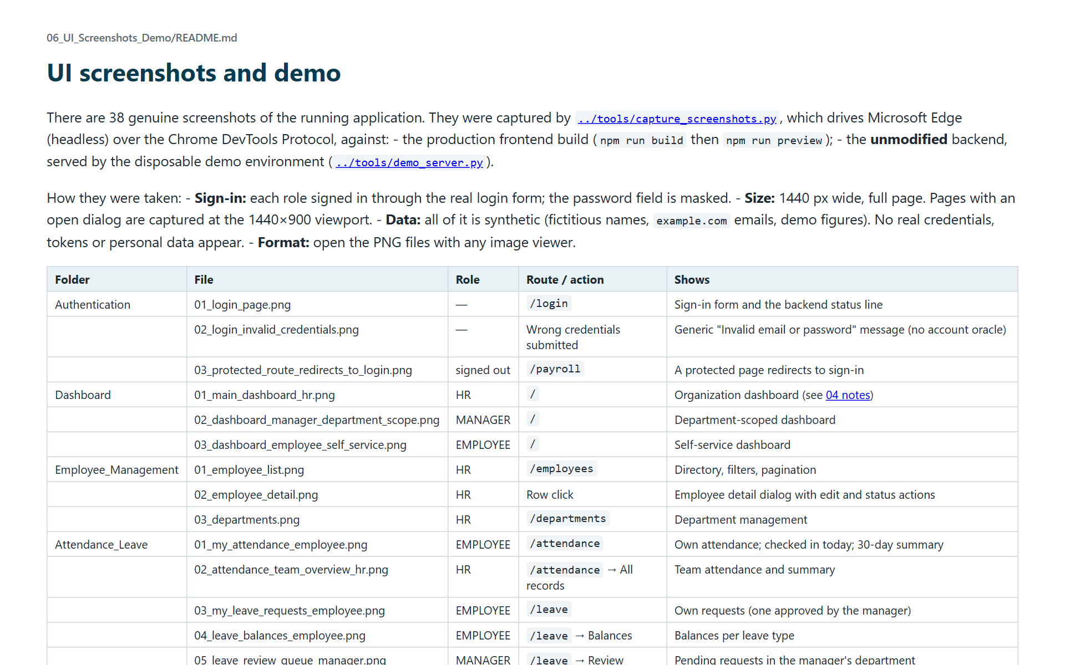
UI screenshots README

Slide 4
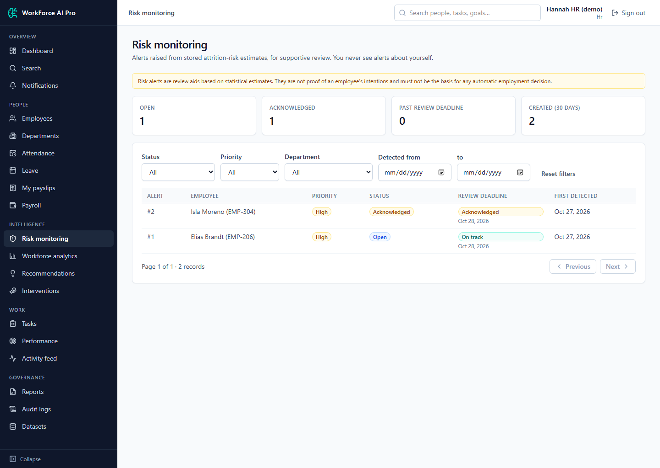
AI Risk Monitoring: Attrition Risk Alerts

Slide 5
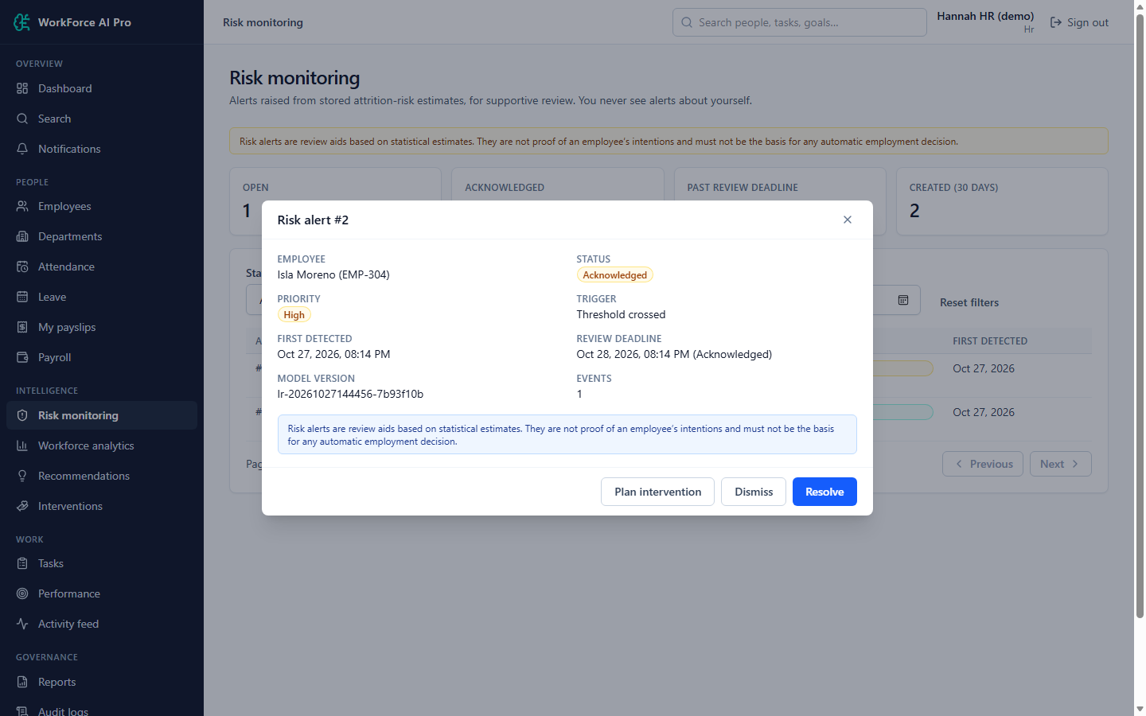
AI Risk Monitoring: Risk Alert Detail

Slide 6
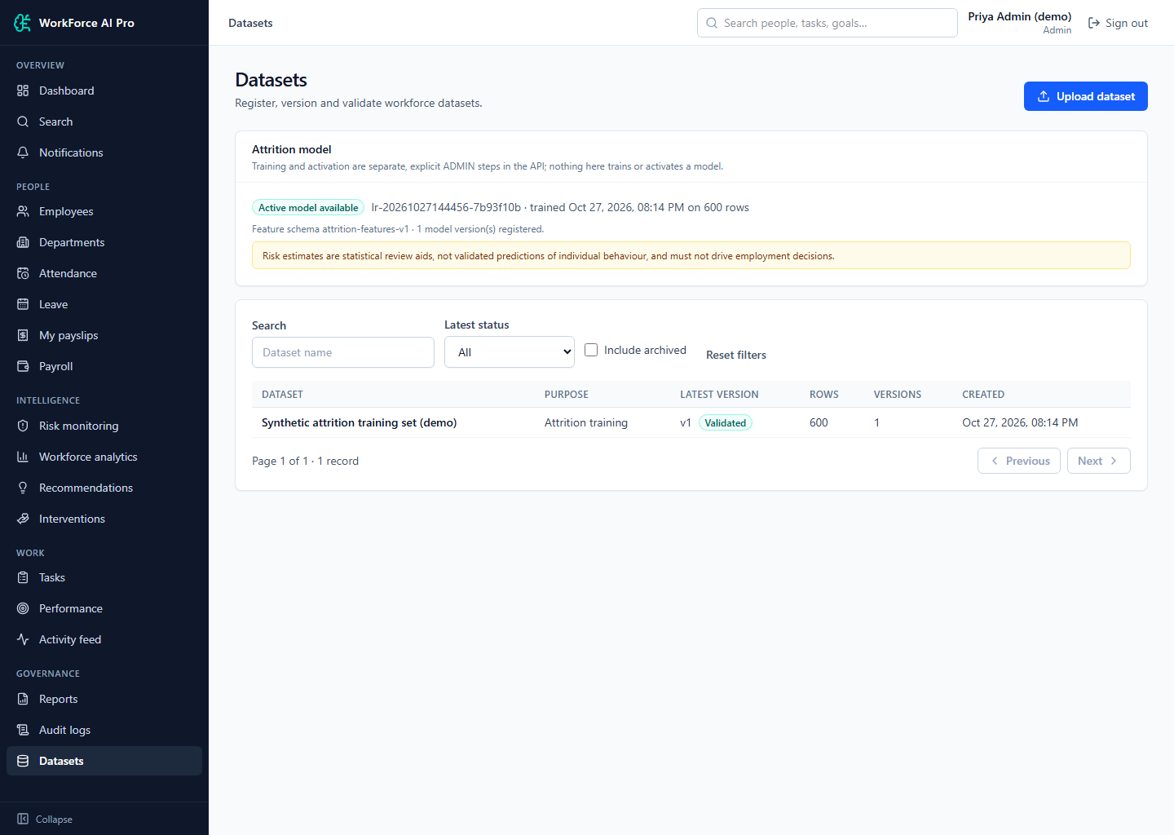
AI Risk Monitoring: Datasets and Model Status (Admin)

Slide 7
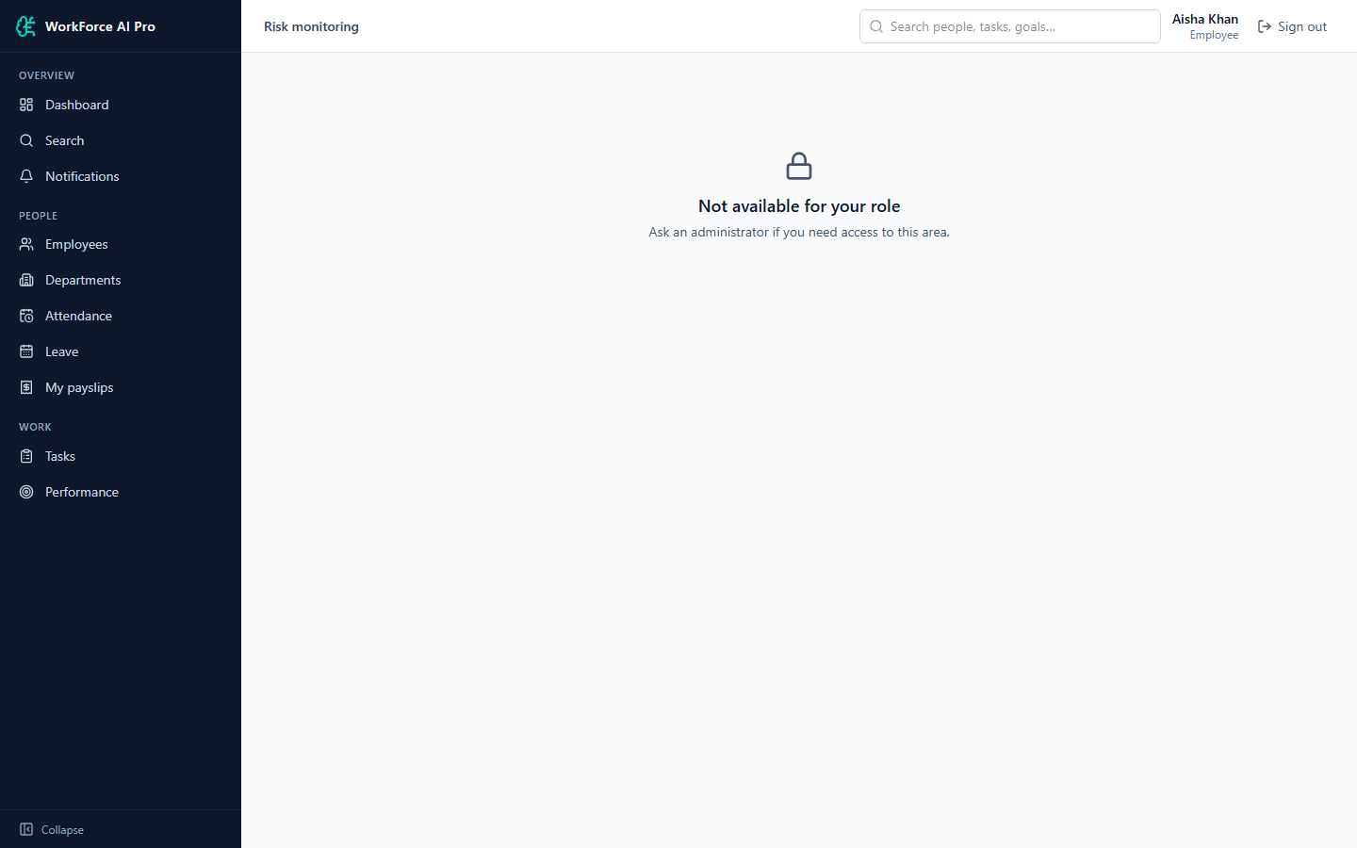
AI Risk Monitoring: Risk Page Not Available to Employee

Slide 8
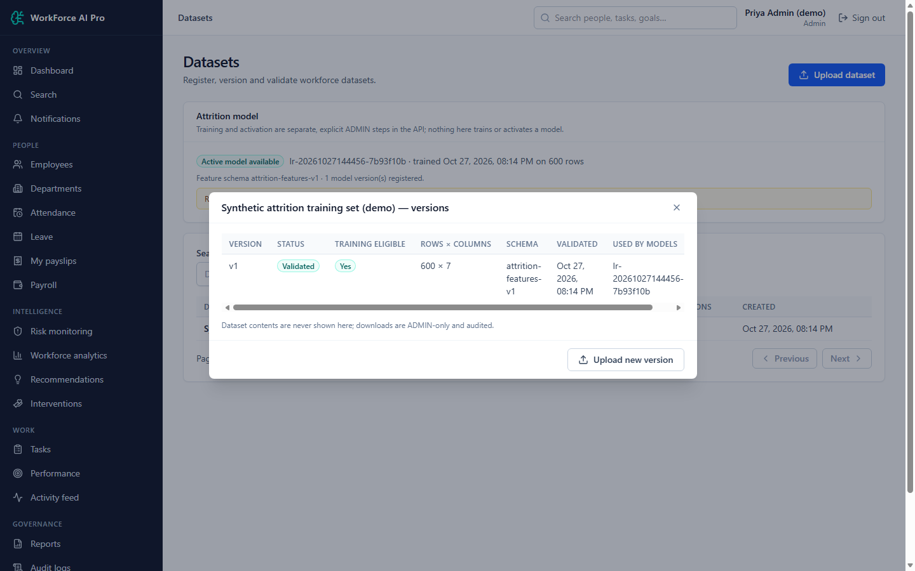
AI Risk Monitoring: Dataset Versions (Admin)

Slide 9
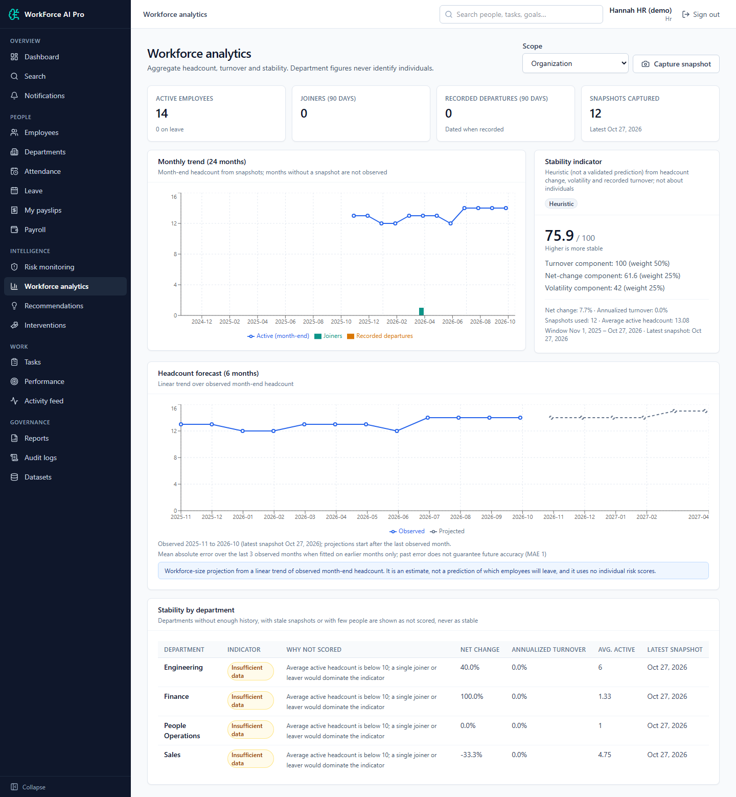
Analytics & Forecasting: Workforce Analytics, Forecast and Stability

Slide 10
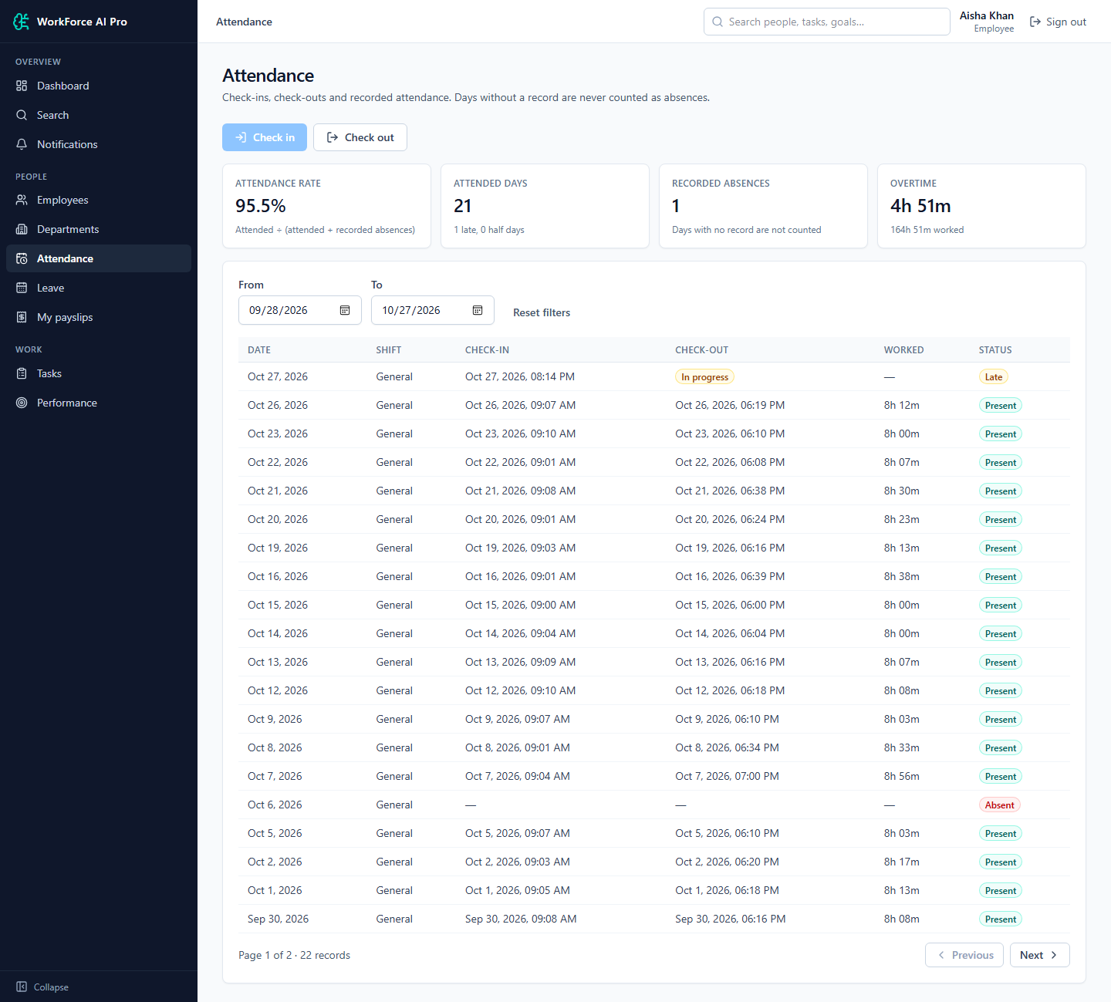
Attendance & Leave: My Attendance (Employee)

Slide 11
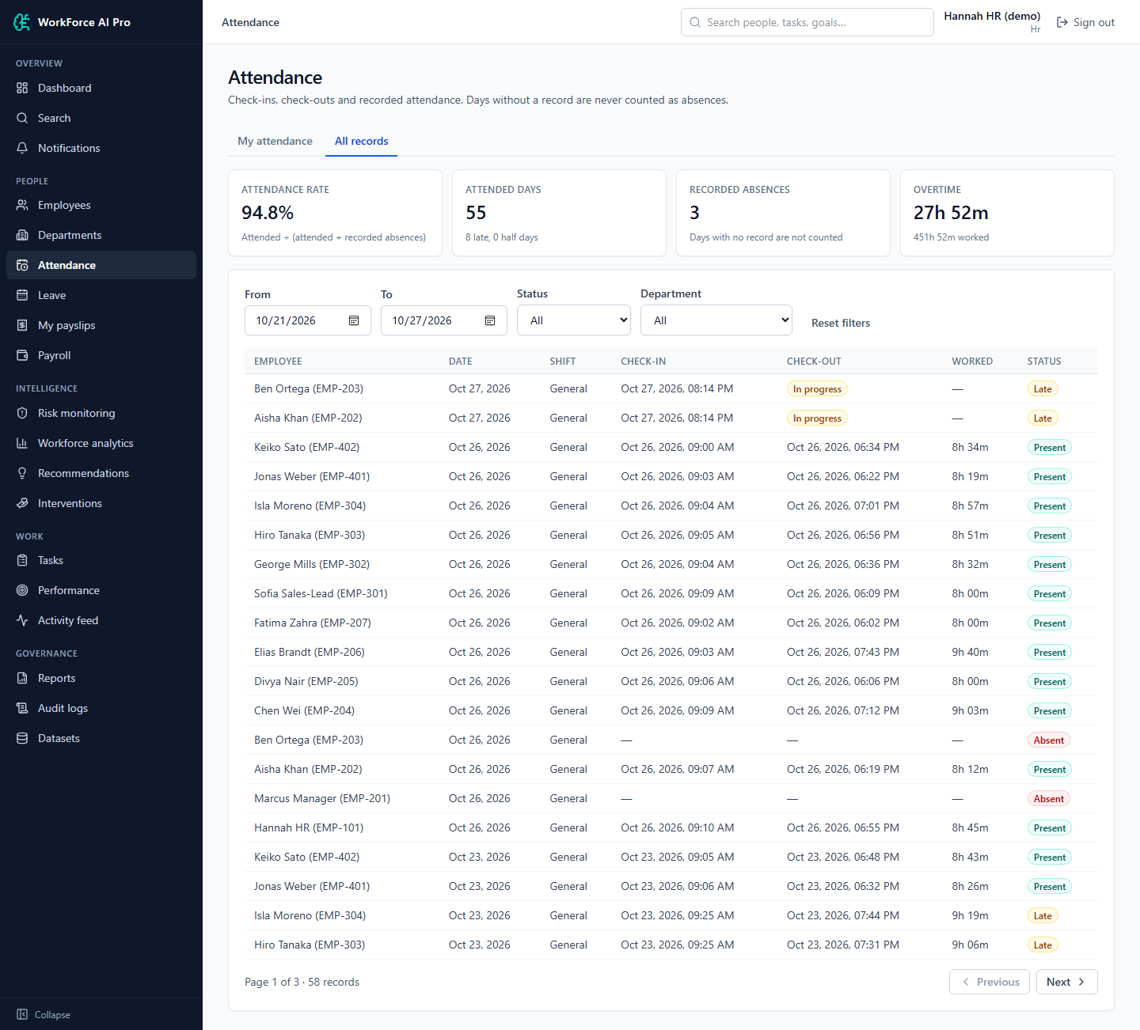
Attendance & Leave: Attendance Team Overview (HR)

Slide 12
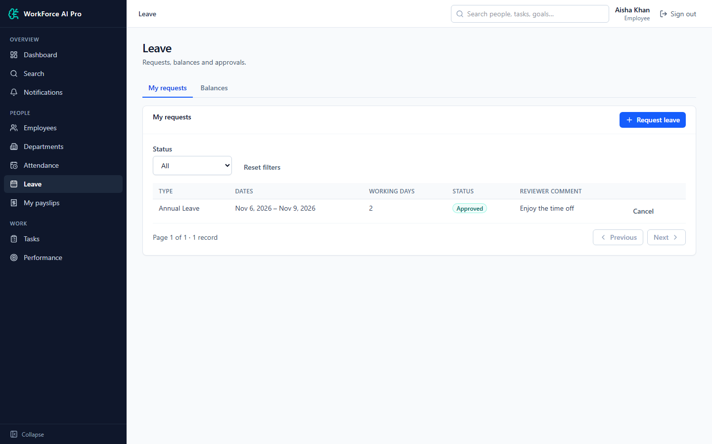
Attendance & Leave: My Leave Requests (Employee)

Slide 13
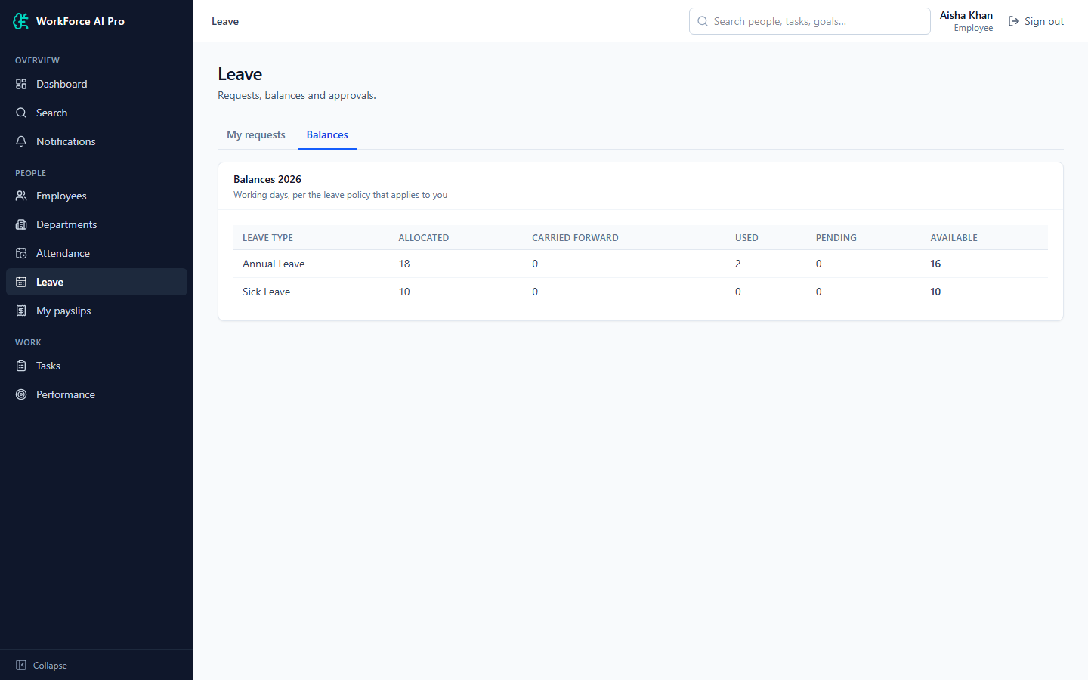
Attendance & Leave: Leave Balances (Employee)

Slide 14
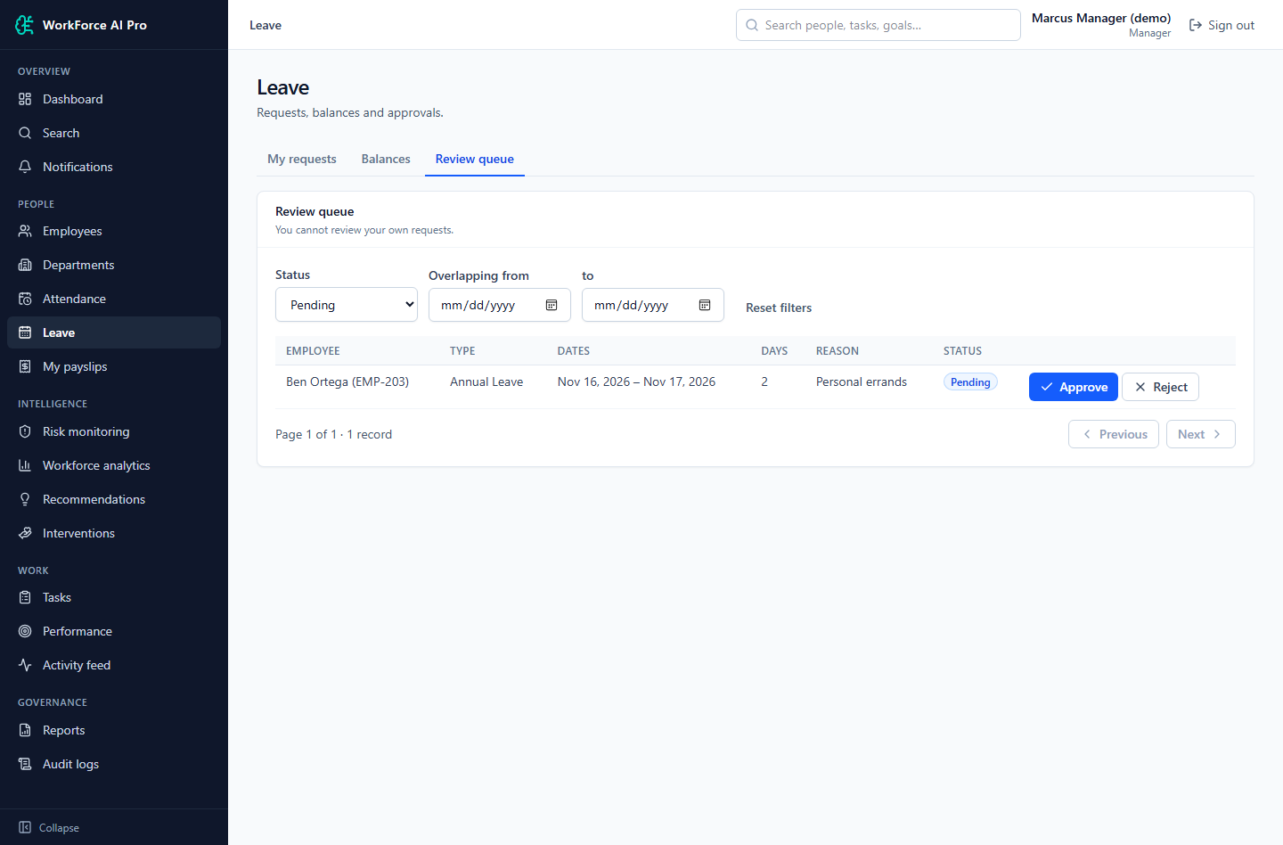
Attendance & Leave: Leave Review Queue (Manager)

Slide 15
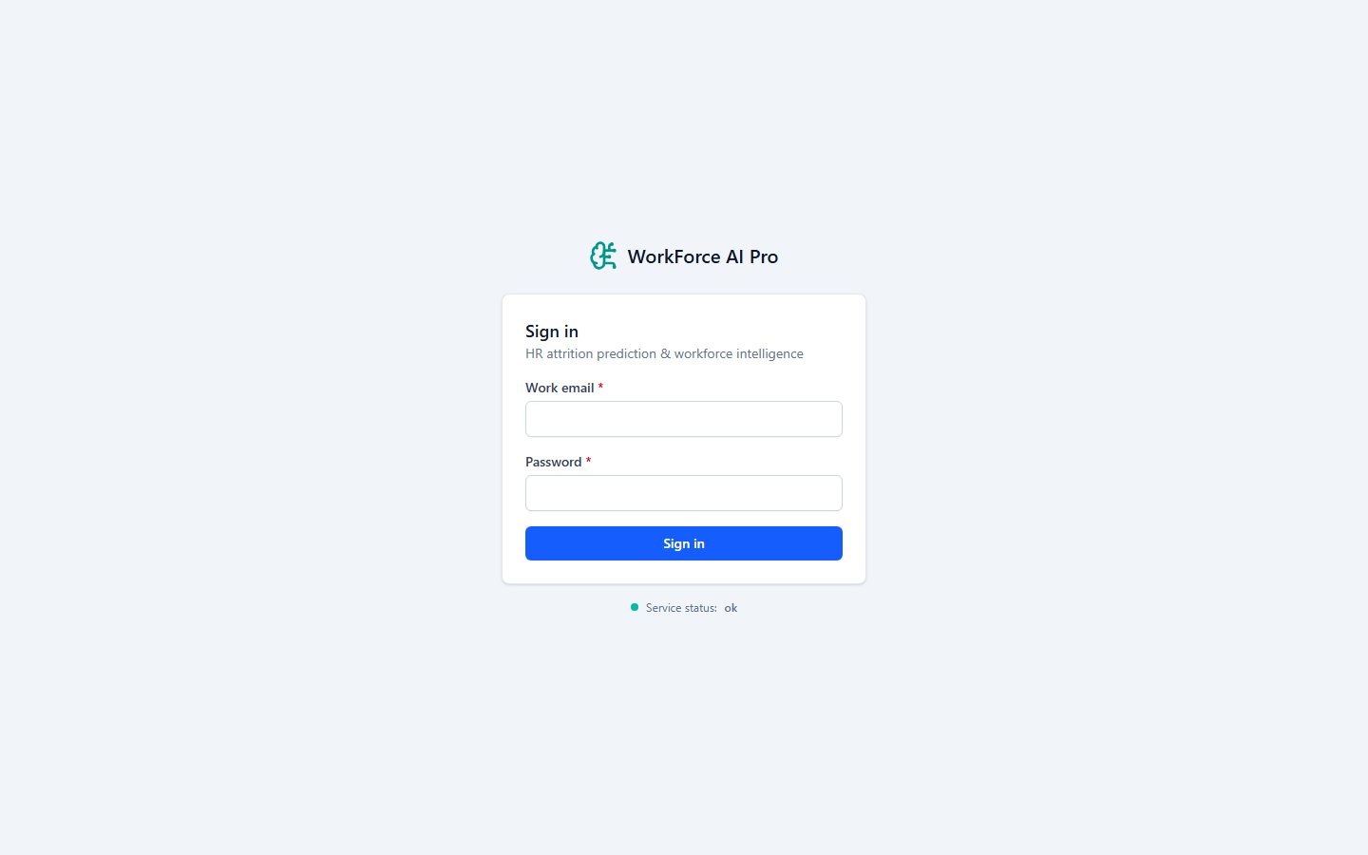
Authentication: Login Page

Slide 16
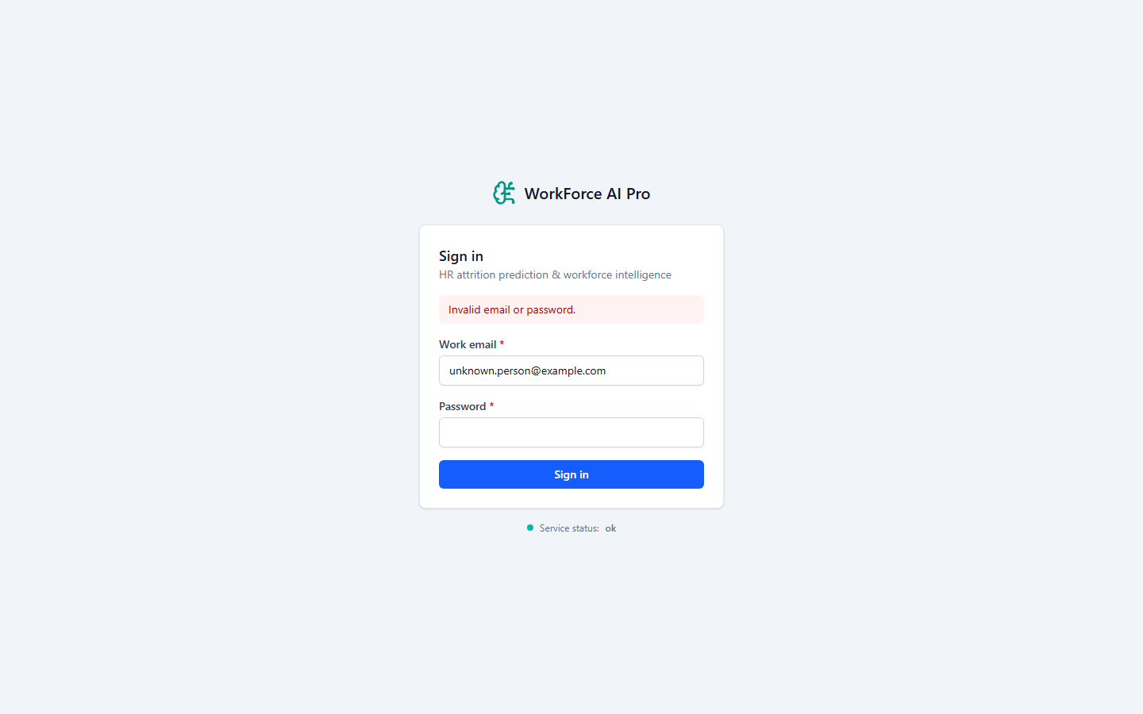
Authentication: Login Invalid Credentials

Slide 17
Authentication: Protected Route Redirects to Login

Slide 18
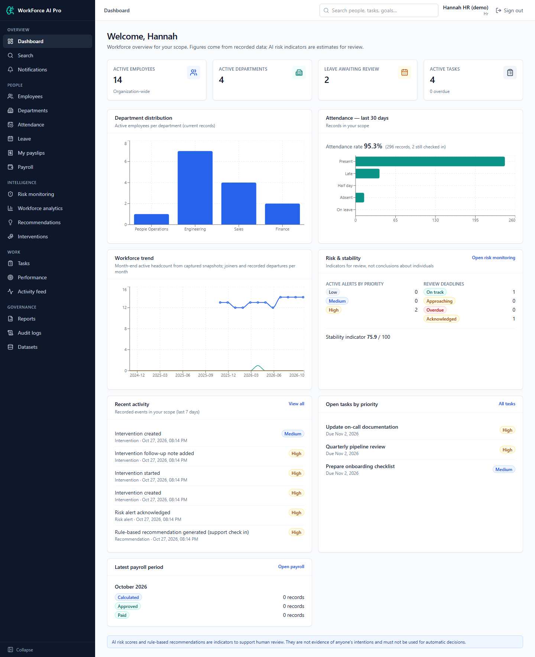
Dashboard: Main Dashboard (HR)

Slide 19
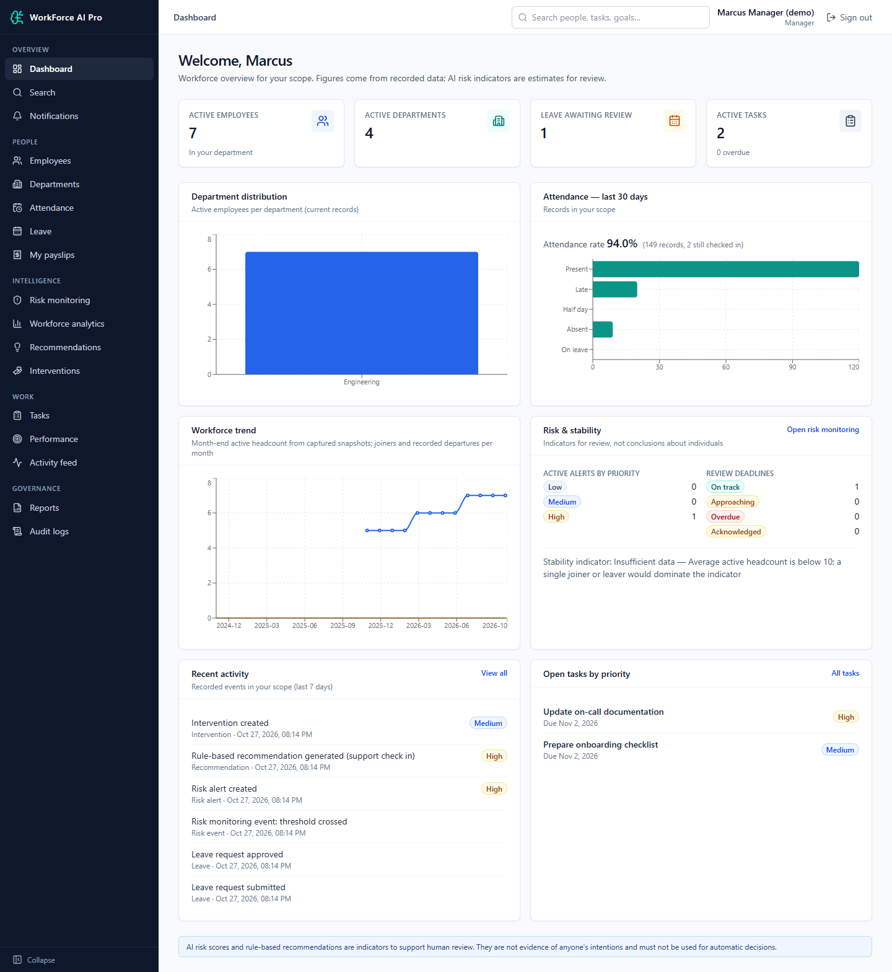
Dashboard: Manager Department Scope

Slide 20
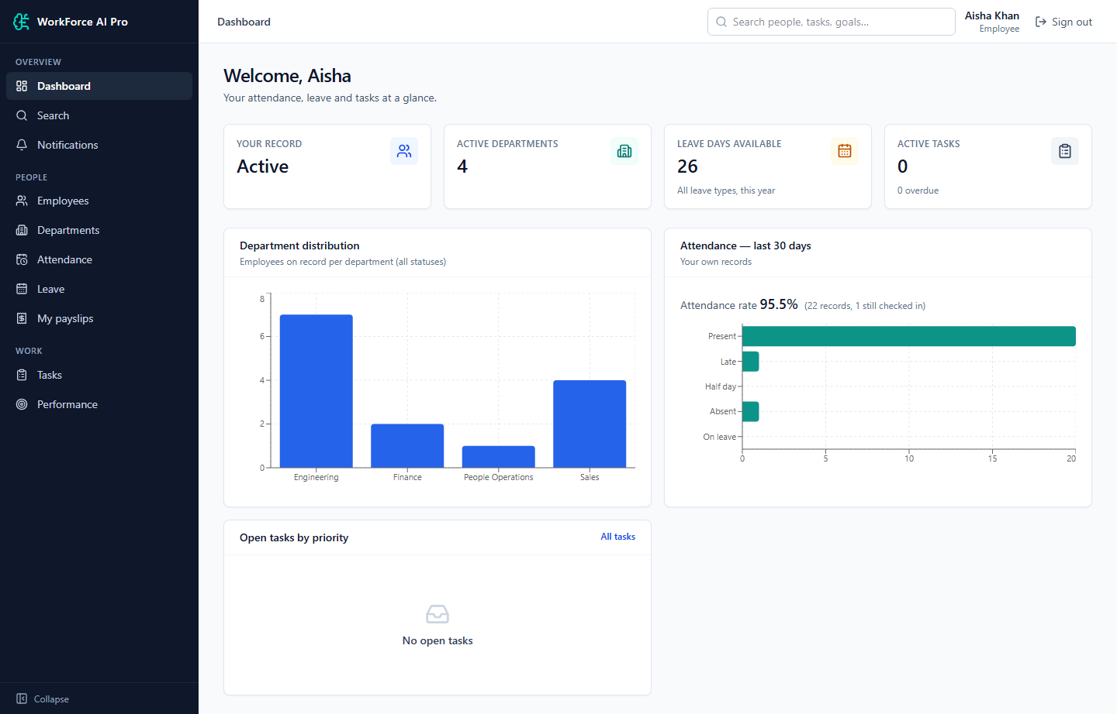
Dashboard: Employee Self-Service

Slide 21
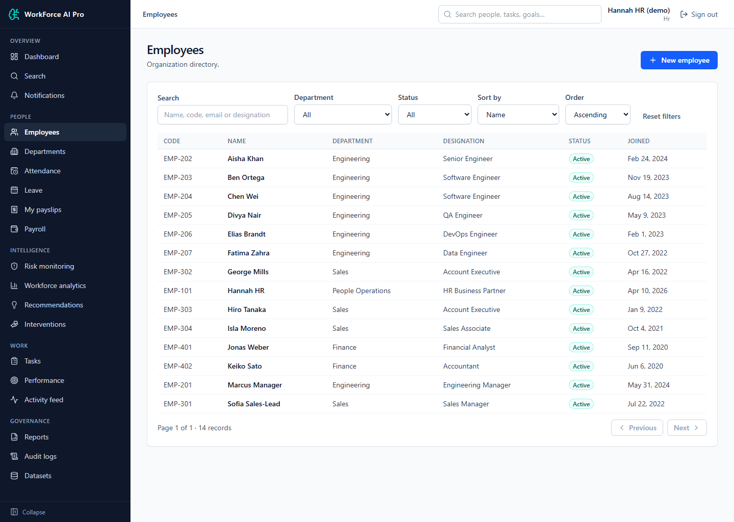
Employee Management: Employee List

Slide 22
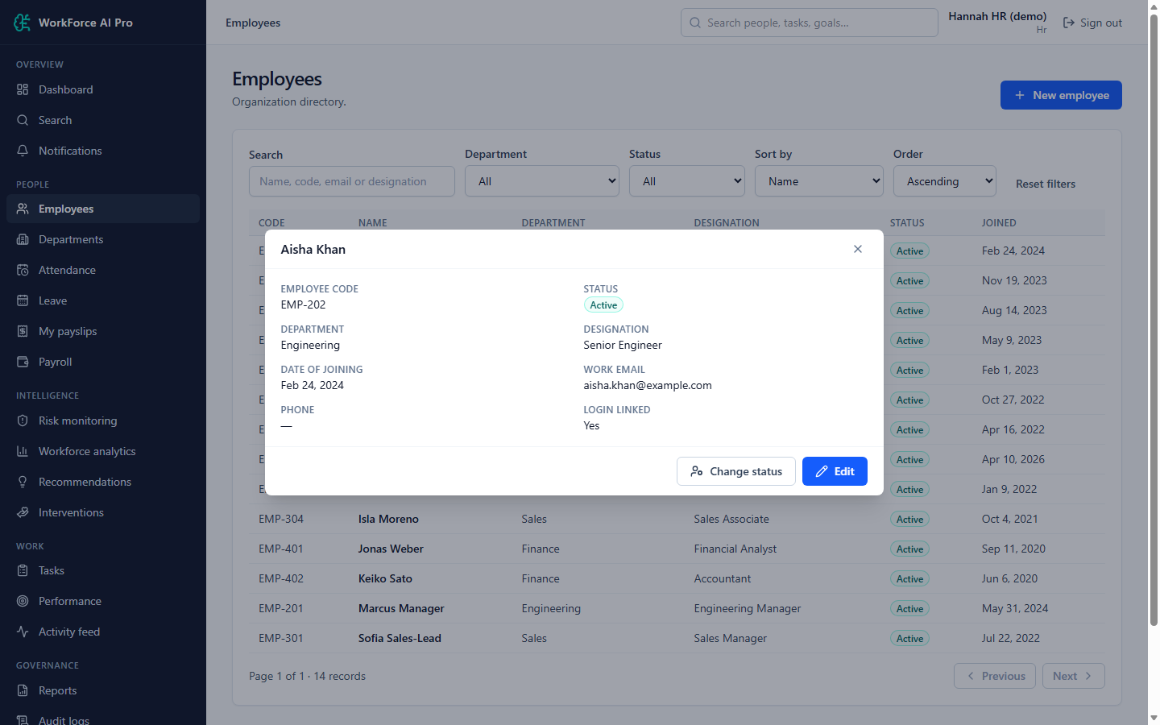
Employee Management: Employee Detail

Slide 23
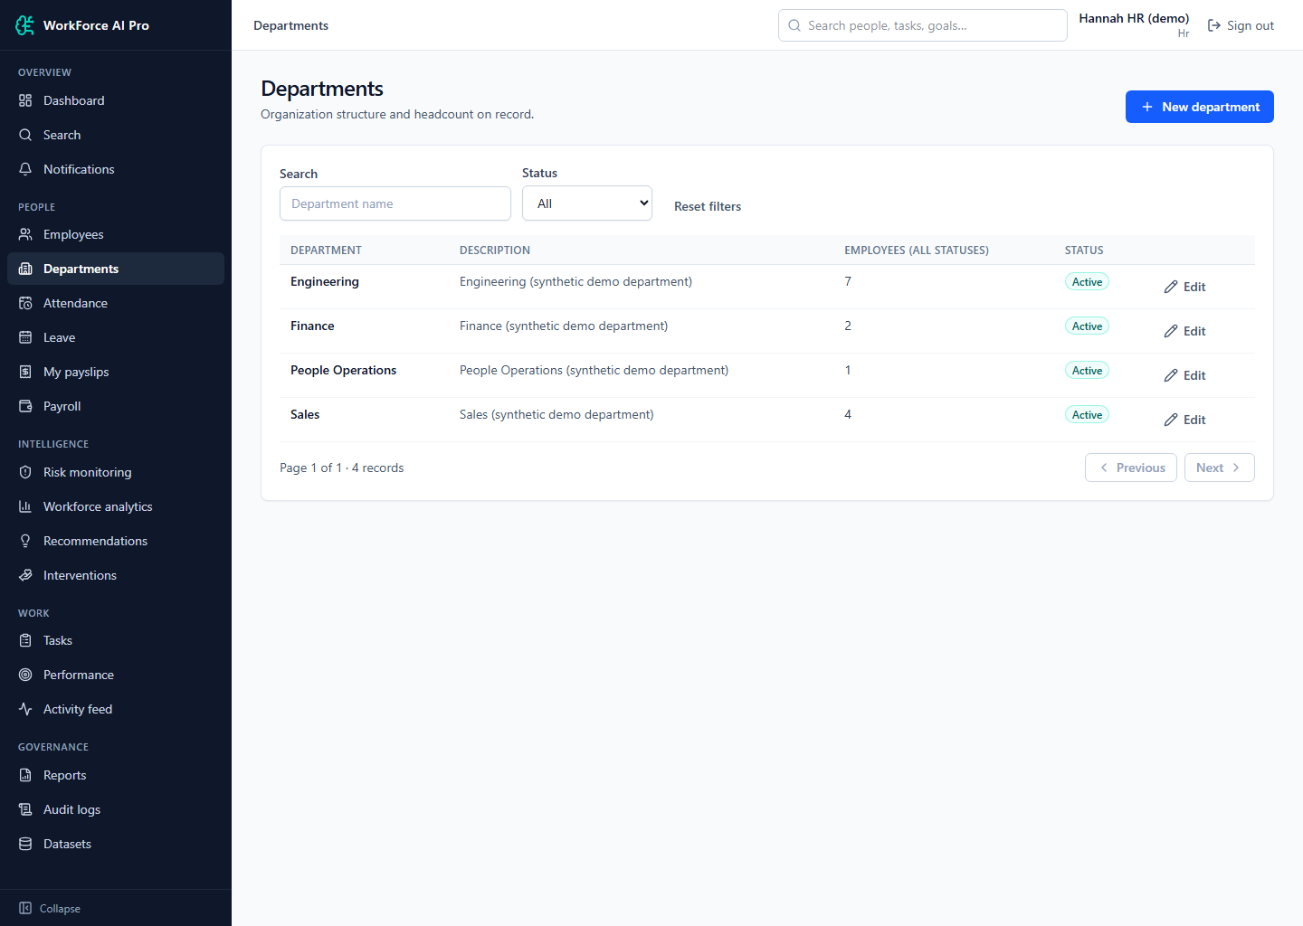
Employee Management: Departments

Slide 24
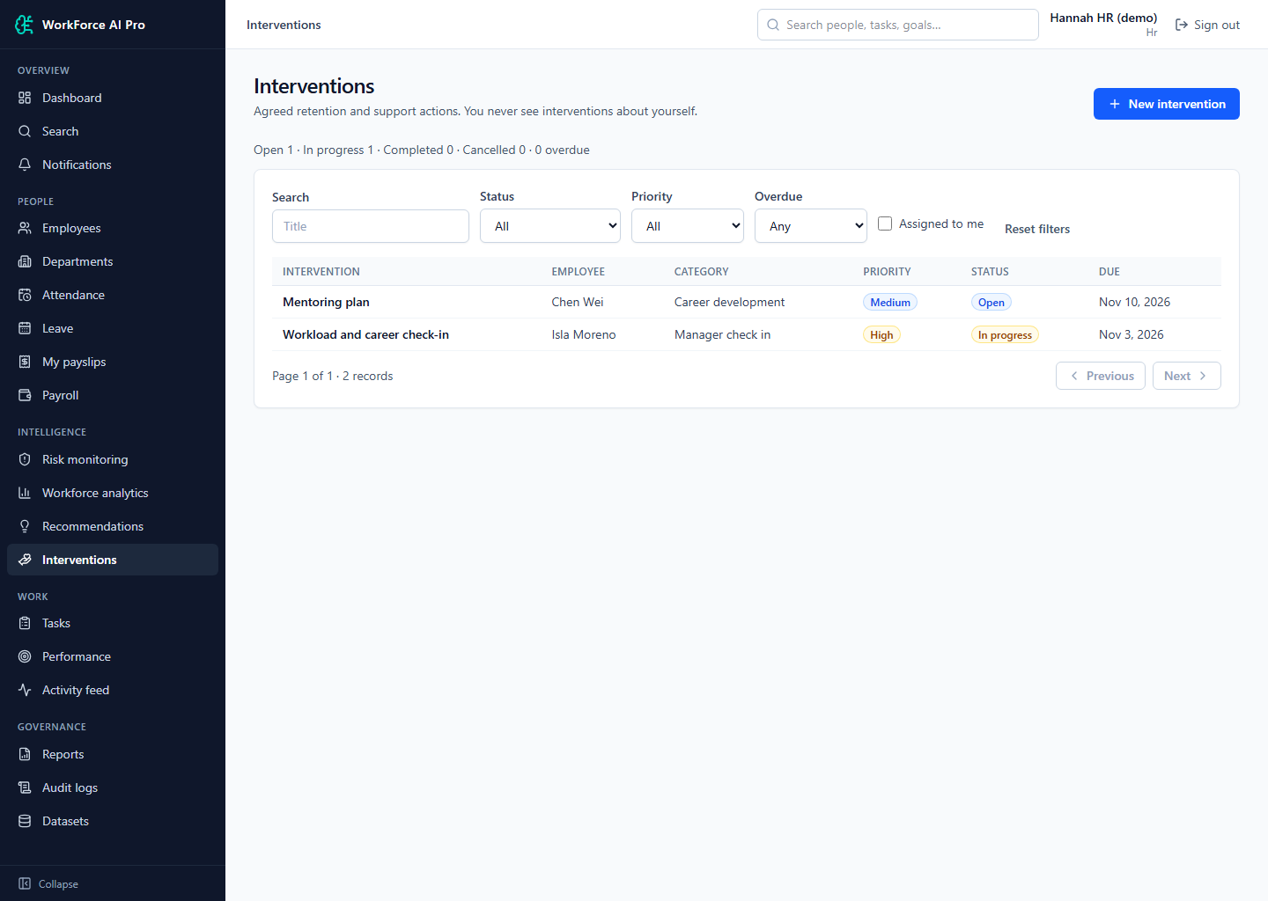
Interventions & Tasks: Interventions

Slide 25
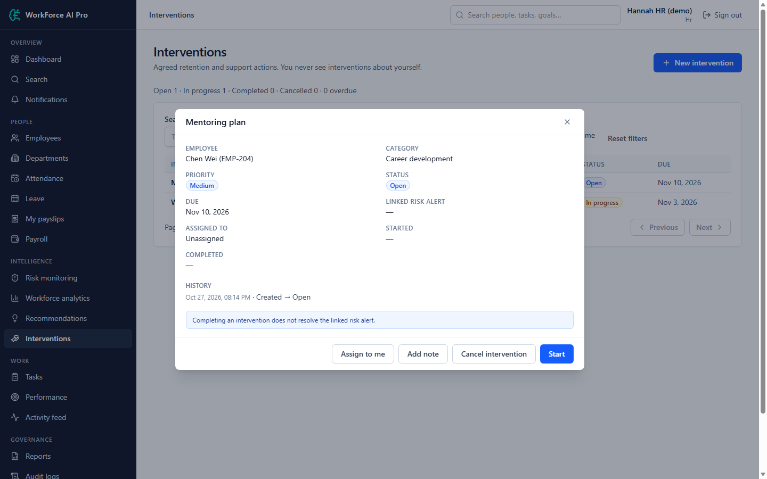
Interventions & Tasks: Intervention Detail and History

Slide 26
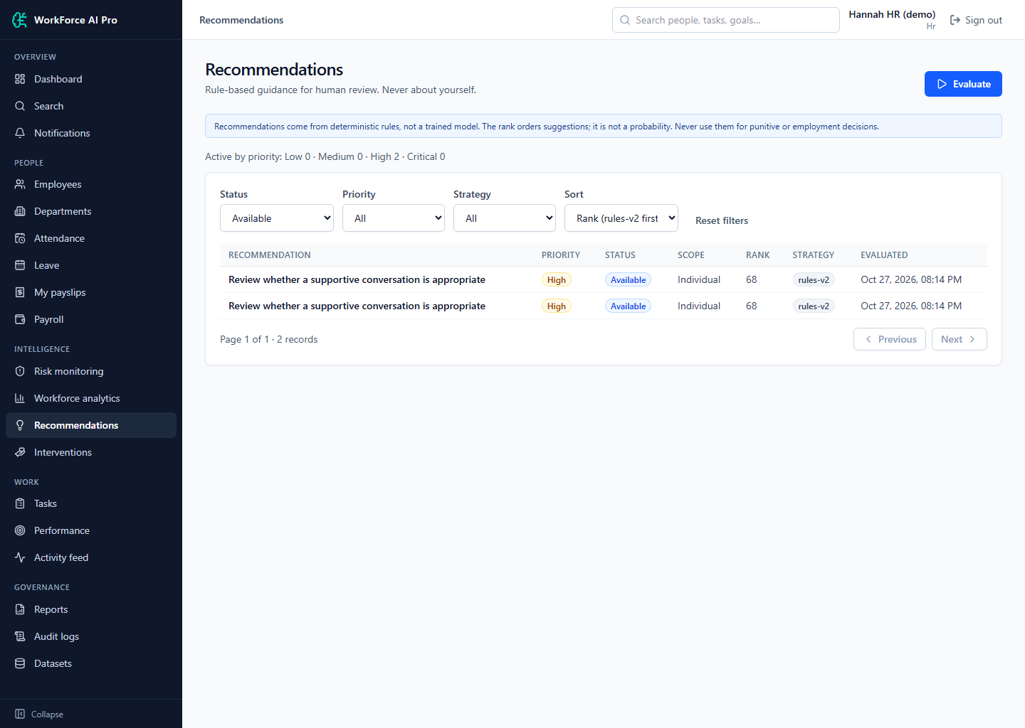
Interventions & Tasks: Recommendations

Slide 27
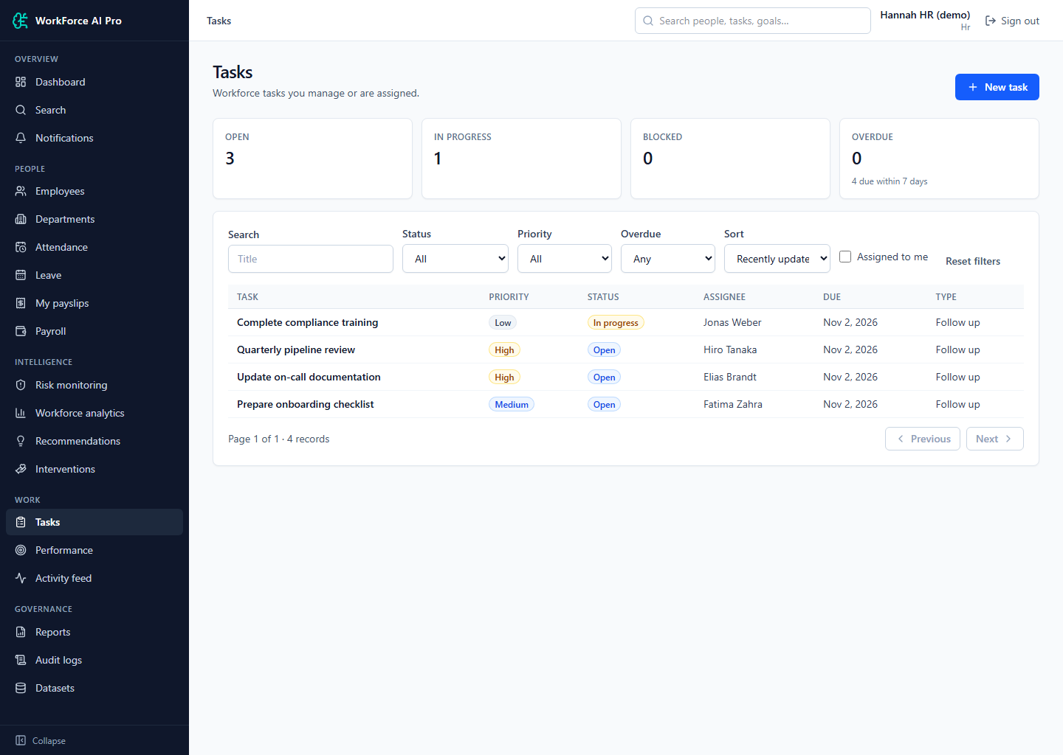
Interventions & Tasks: Tasks

Slide 28
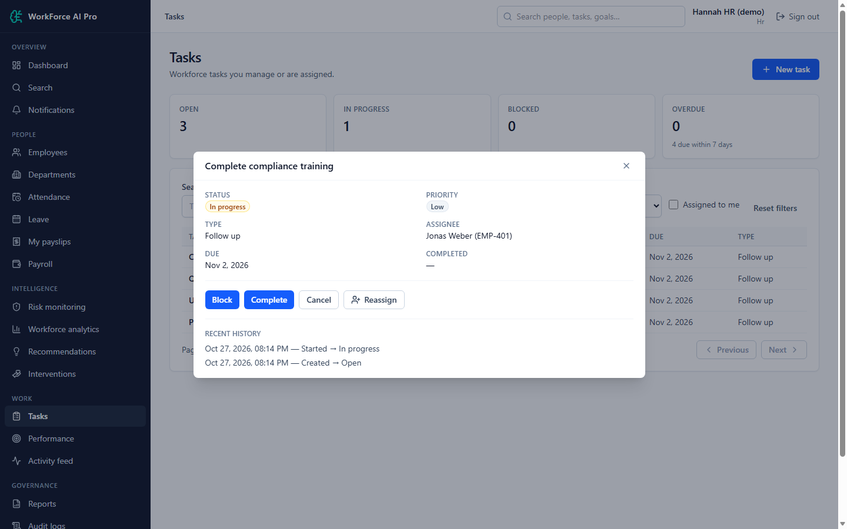
Interventions & Tasks: Task Detail

Slide 29
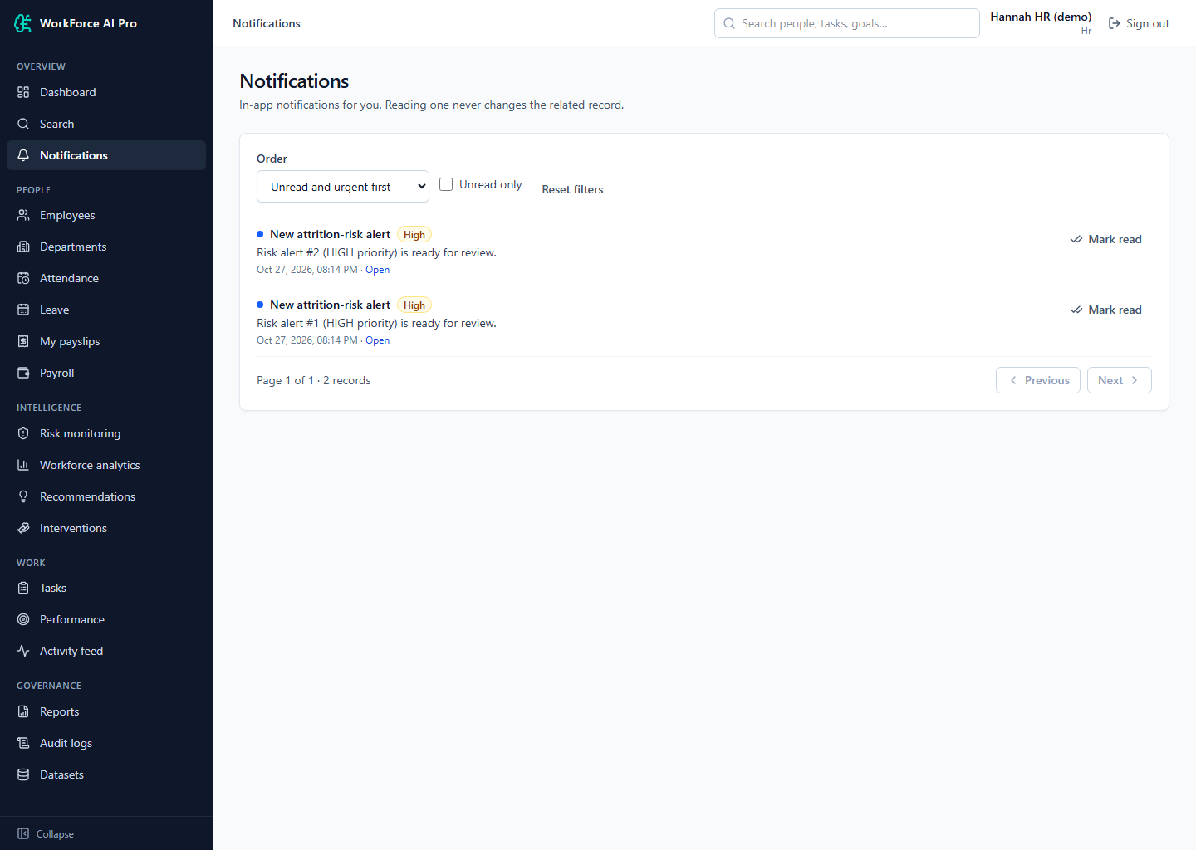
Notifications & Search: Notifications

Slide 30
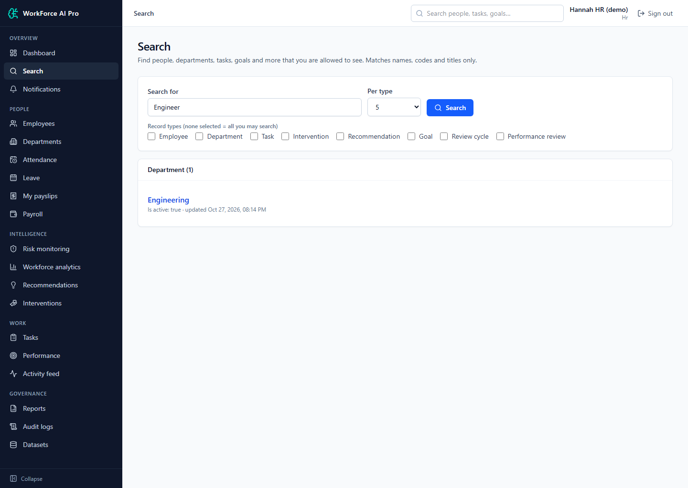
Notifications & Search: Global Search

Slide 31
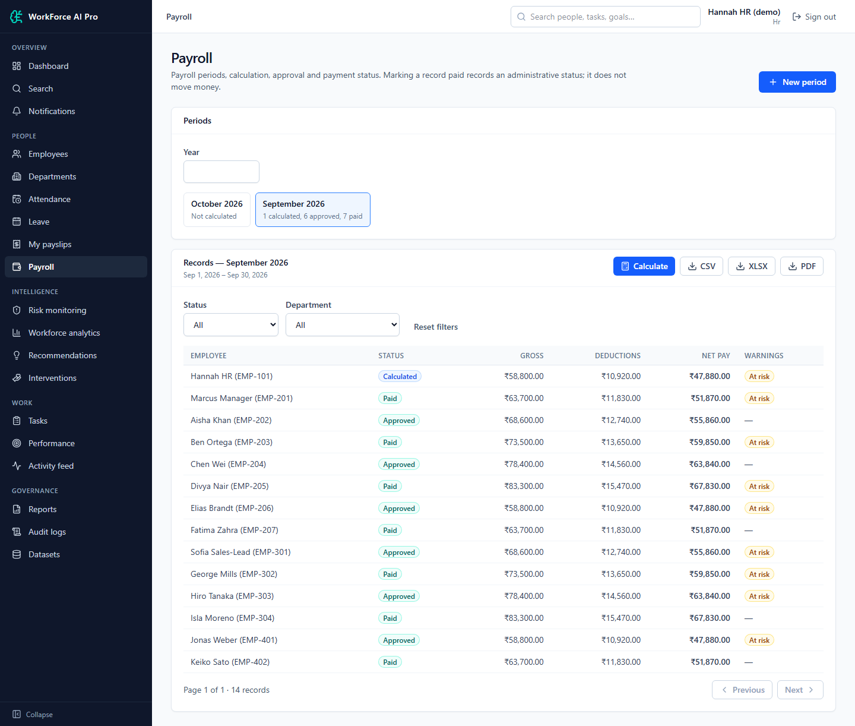
Payroll: Payroll Periods and Records

Slide 32
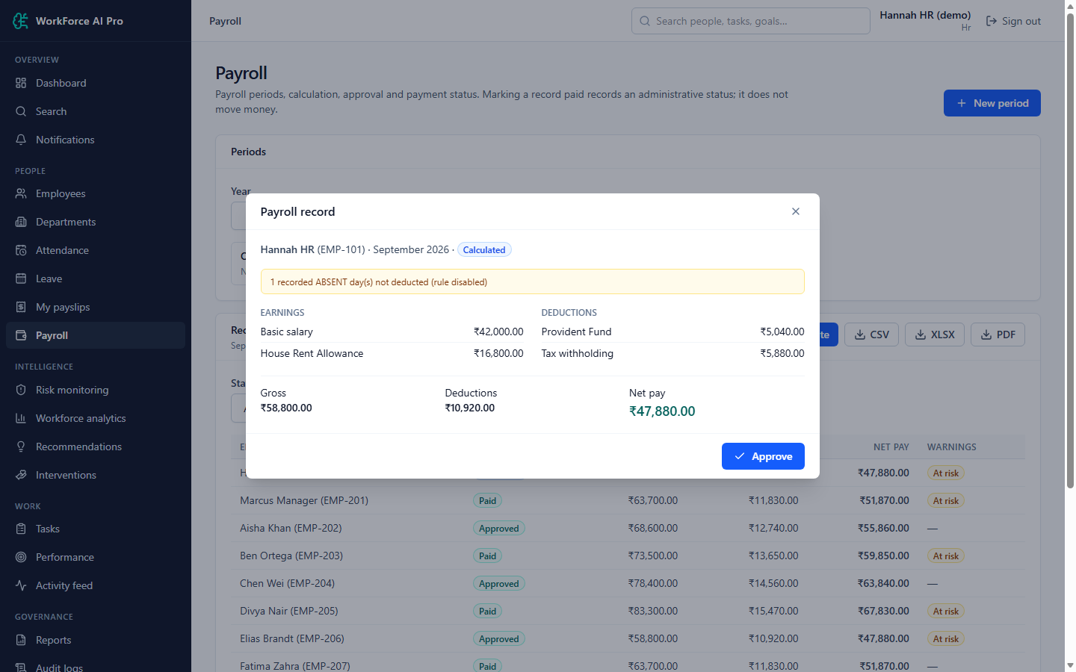
Payroll: Payroll Record Detail

Slide 33
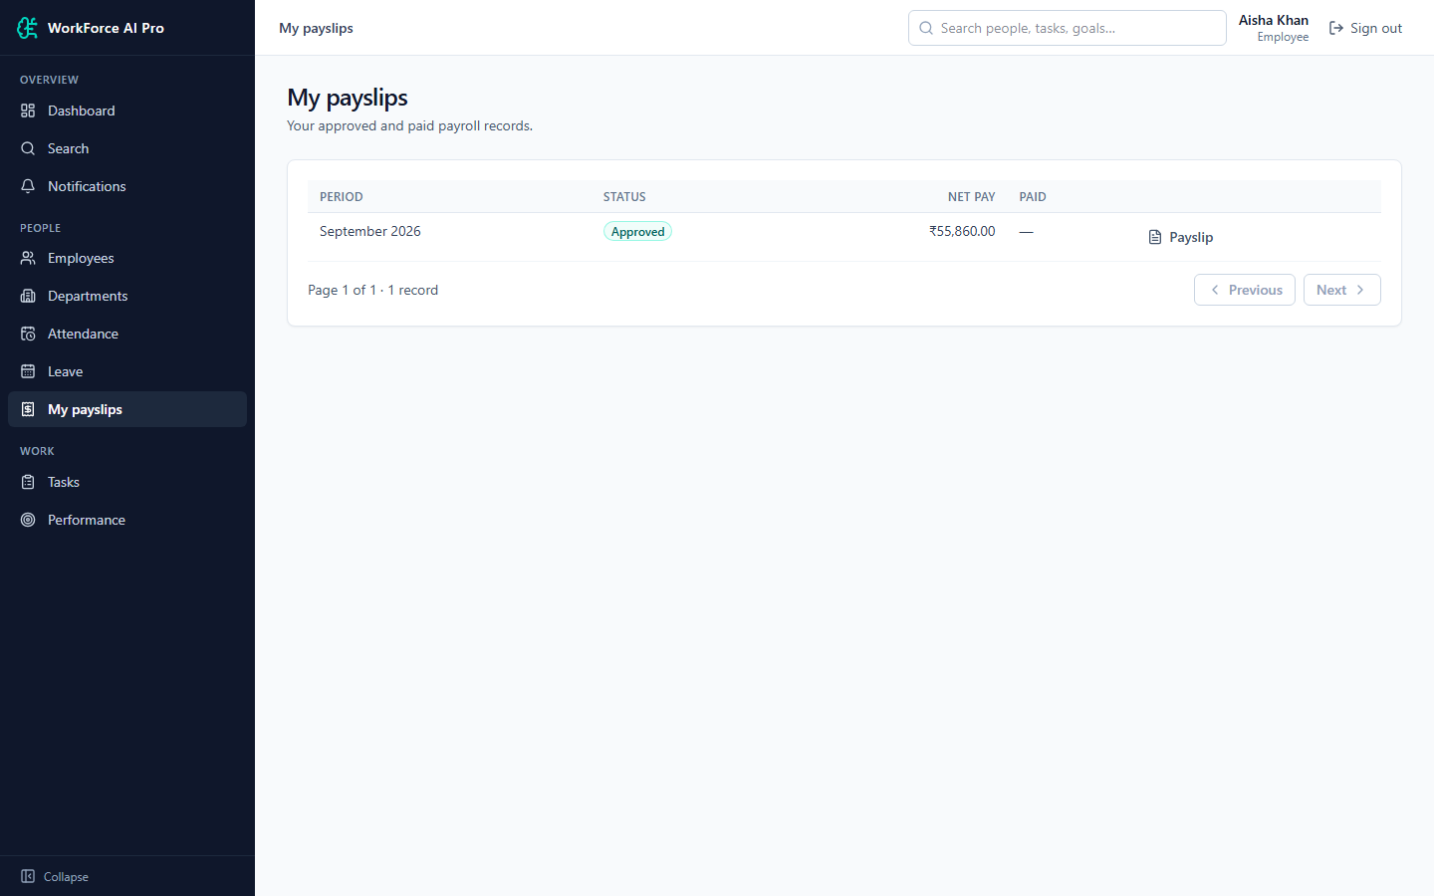
Payroll: My Payslips (Employee)

Slide 34
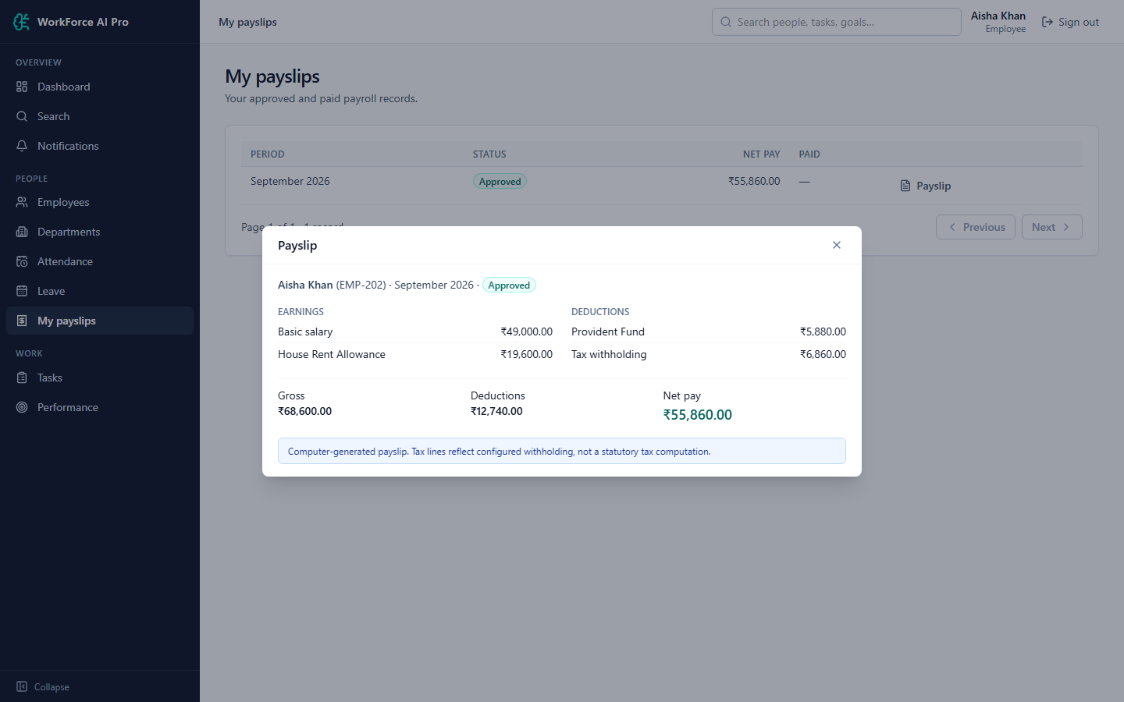
Payroll: Payslip Dialog (Employee)

Slide 35
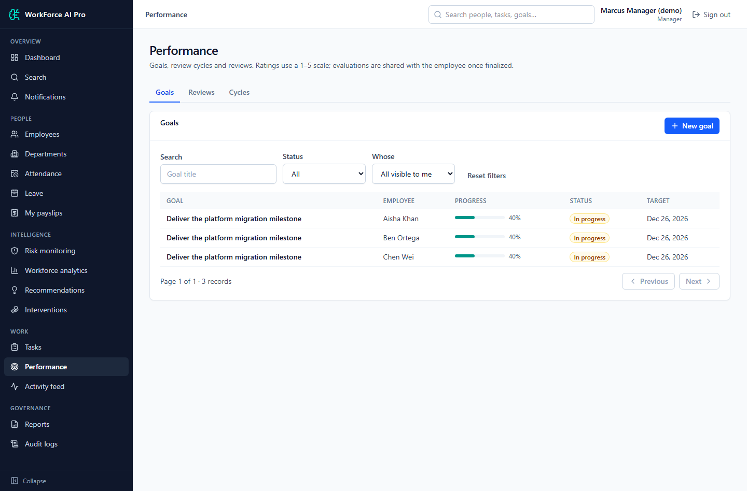
Performance Reviews: Goals (Manager)

Slide 36
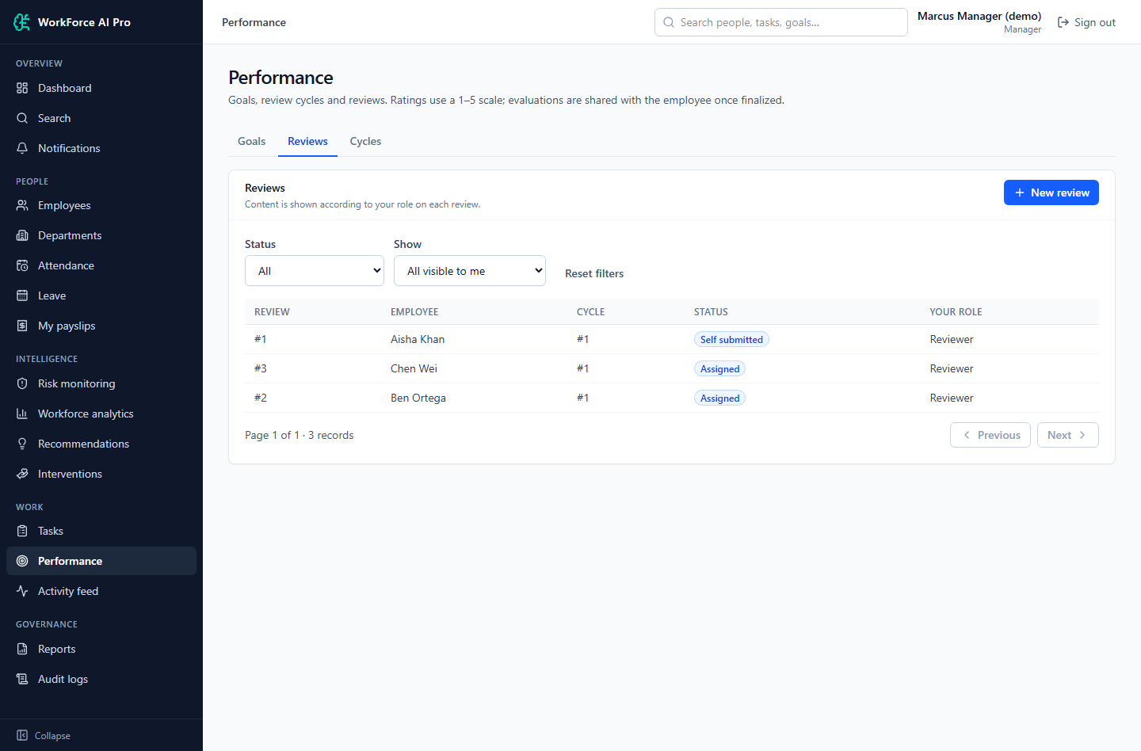
Performance Reviews: Reviews (Manager)

Slide 37
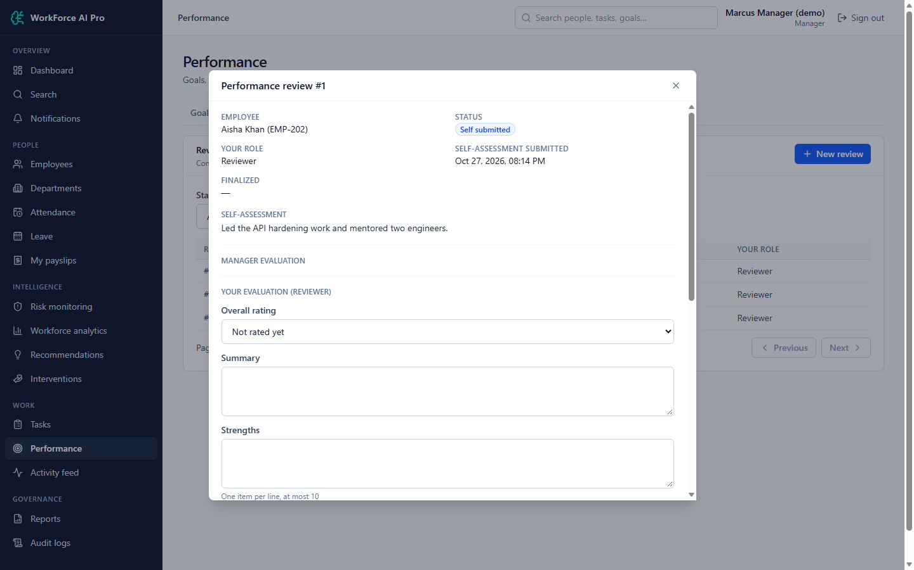
Performance Reviews: Review Detail and Reviewer Evaluation

Slide 38
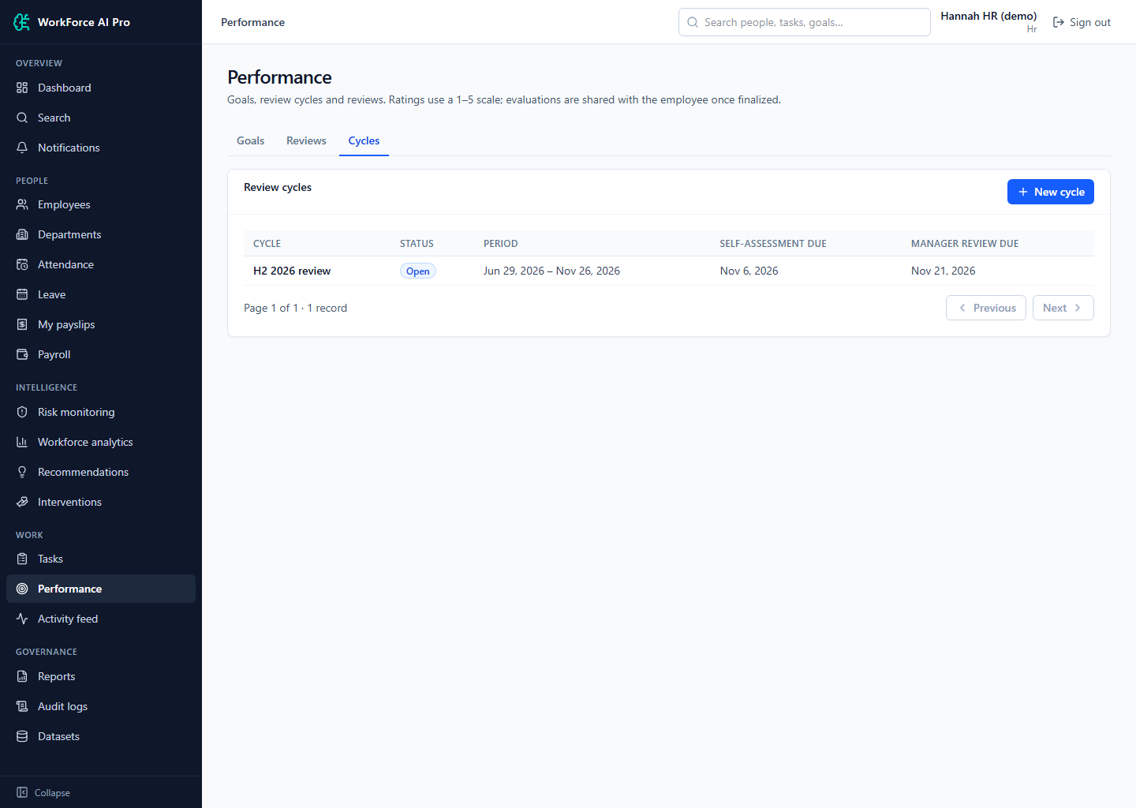
Performance Reviews: Review Cycles (HR)

Slide 39
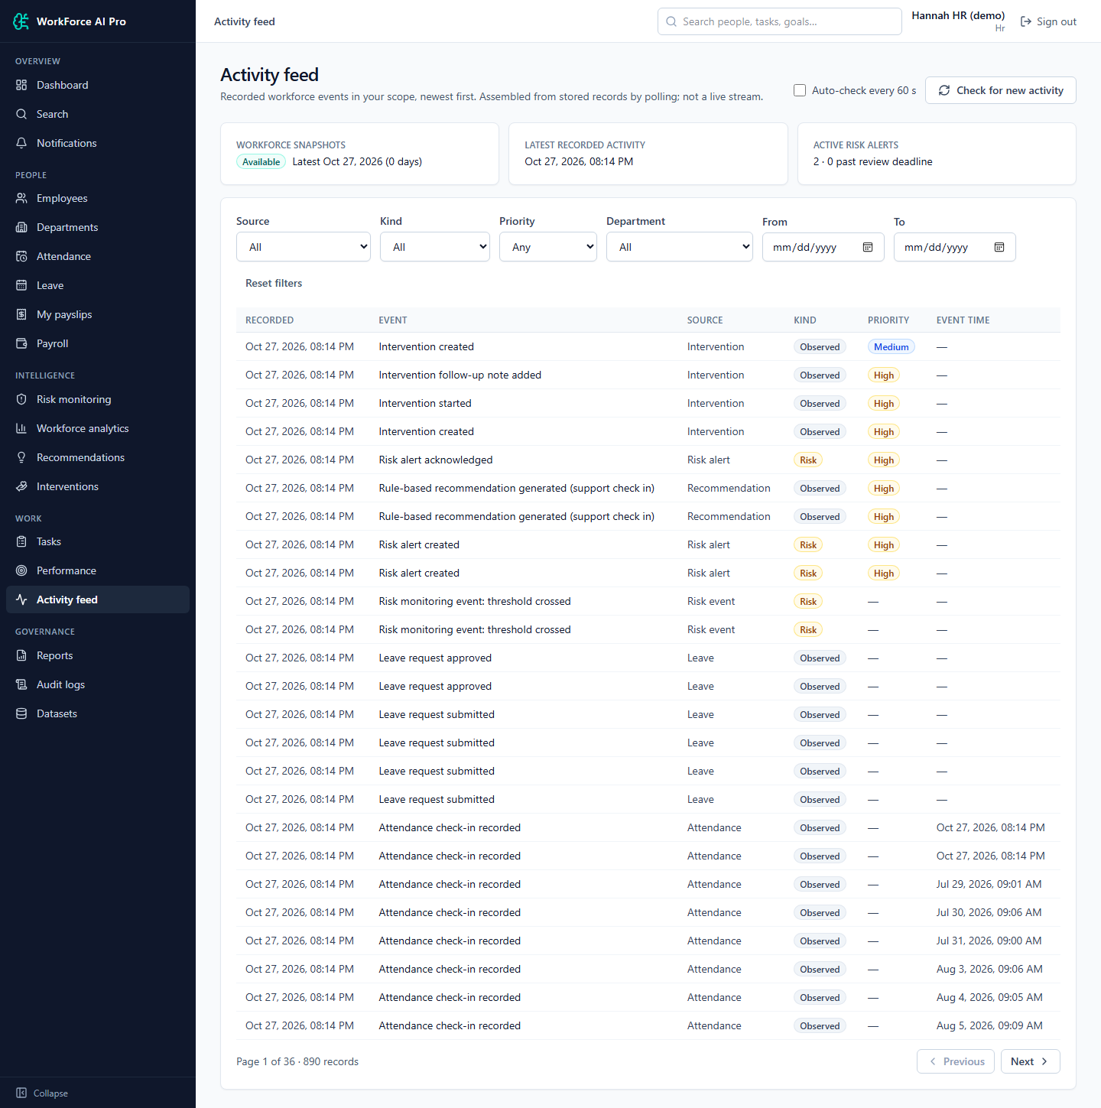
Reports & Audit: Activity Feed and Monitoring Status

Slide 40
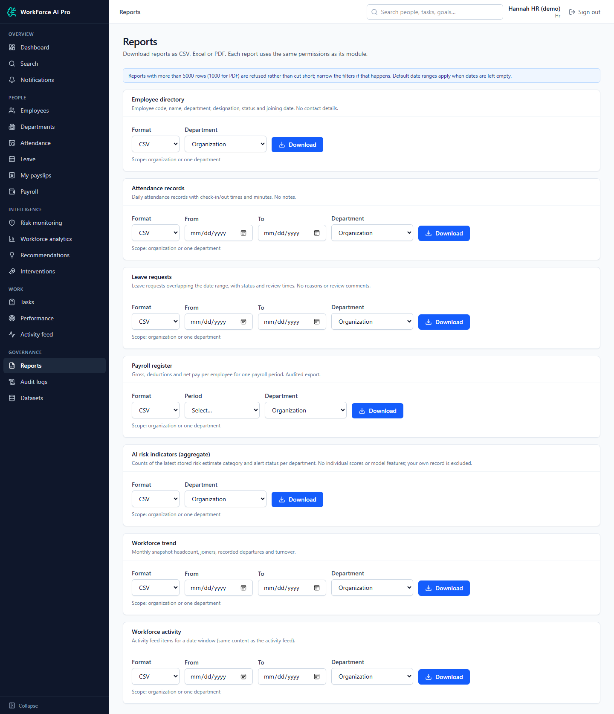
Reports & Audit: Reports and Exports

Slide 41
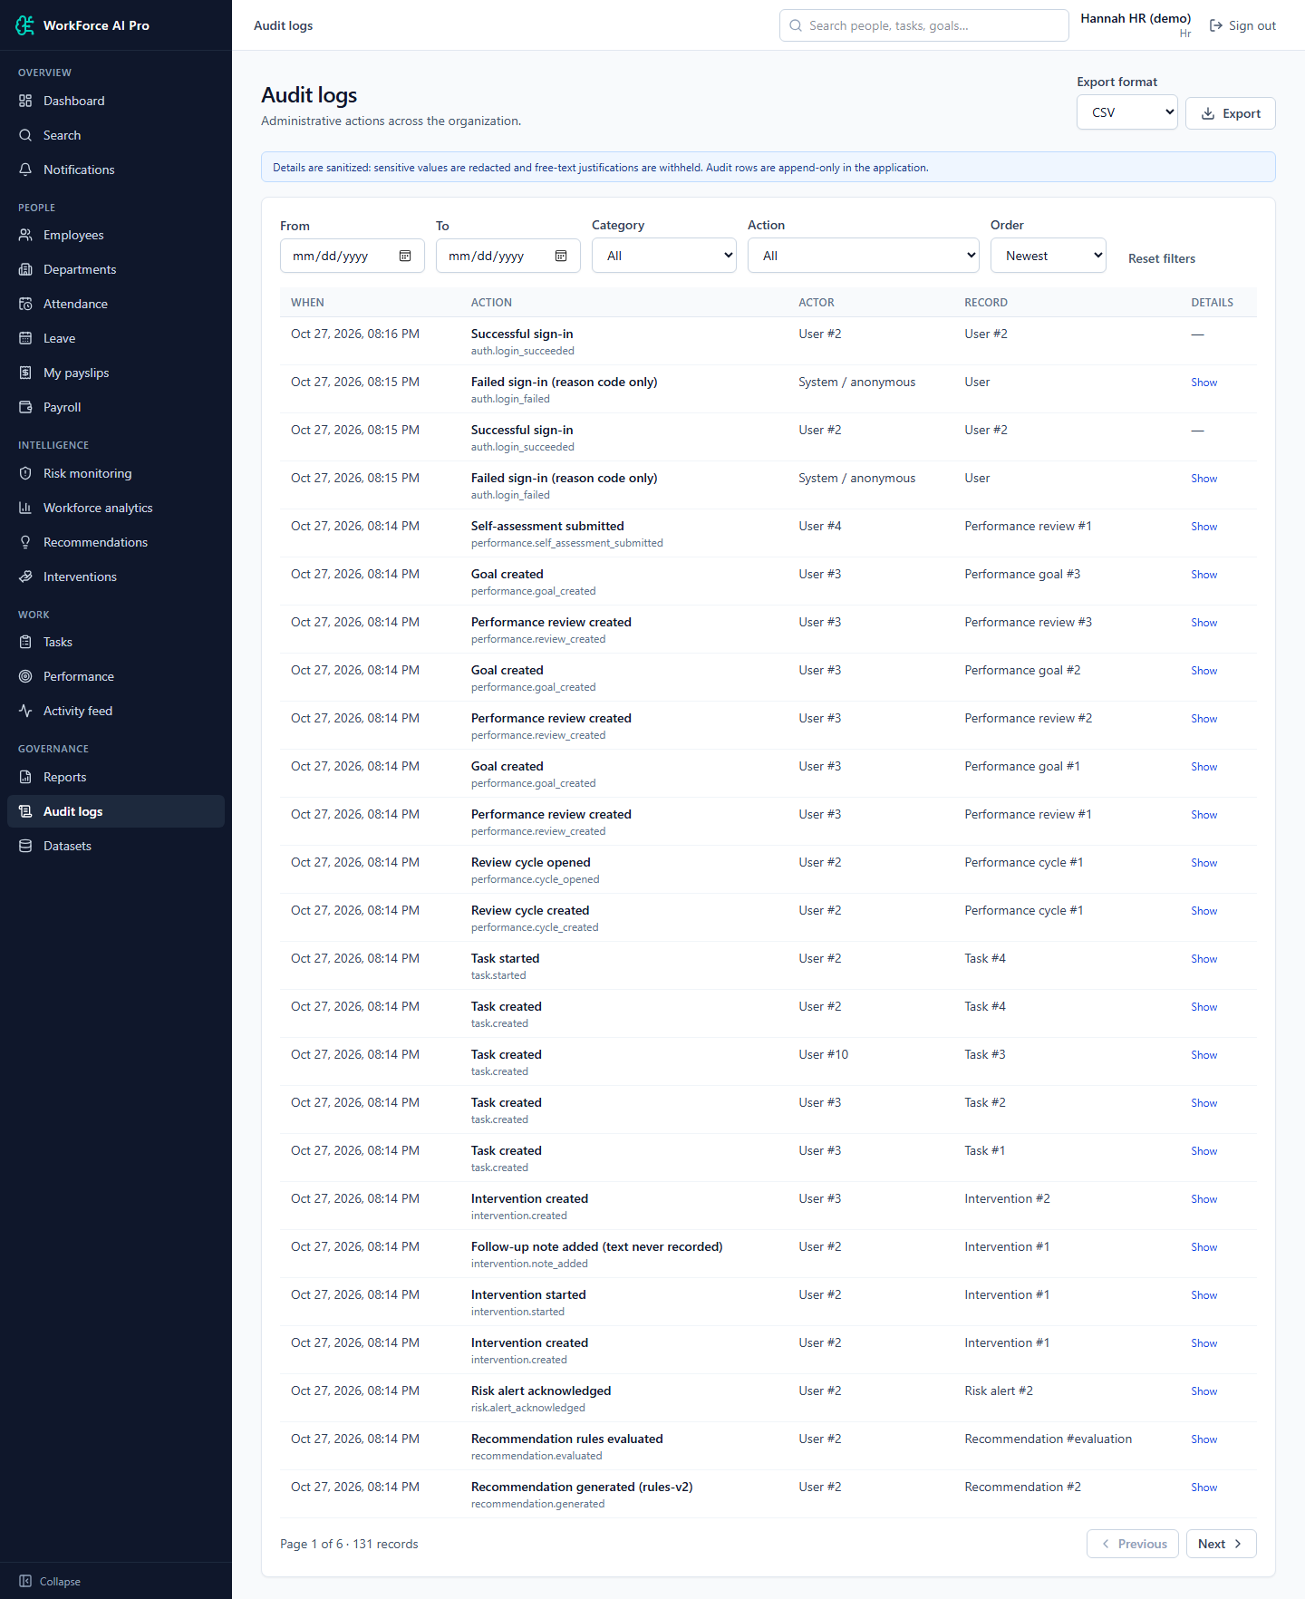
Reports & Audit: Audit Logs

Slide 42
Workforce Dashboards
Dashboard views for HR, managers and employees

Slide 43
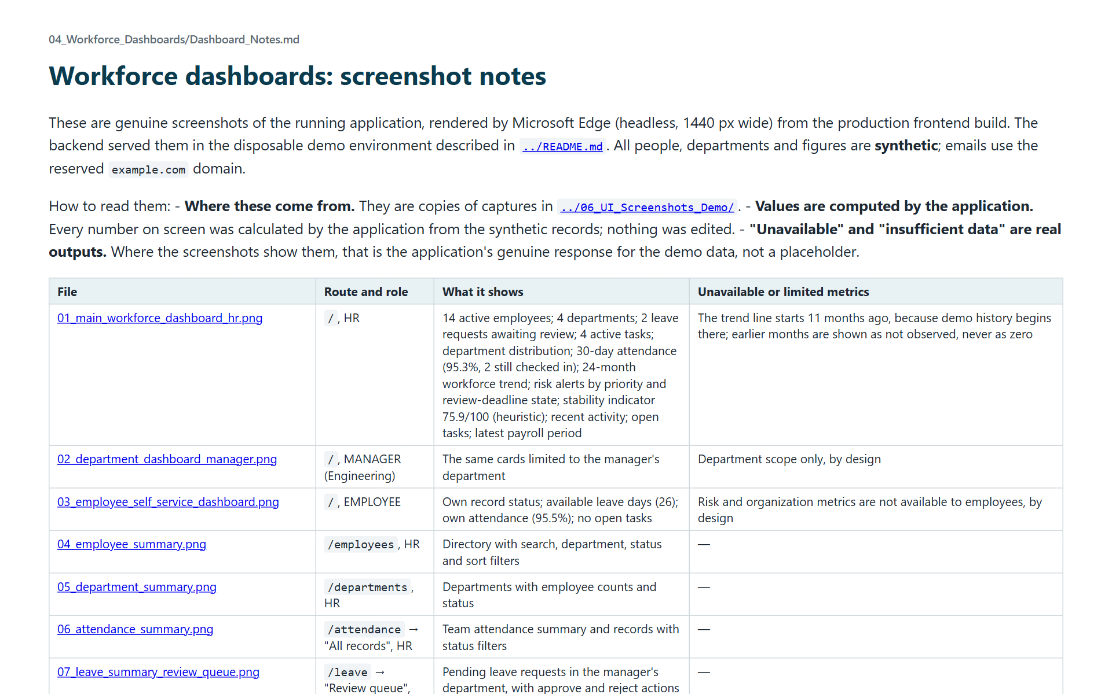
Dashboard notes

Slide 44
Workforce Dashboard: Main Workforce Dashboard (HR)

Slide 45
Workforce Dashboard: Department Dashboard (Manager)

Slide 46
Workforce Dashboard: Employee Self-Service Dashboard

Slide 47
Workforce Dashboard: Employee Summary

Slide 48
Workforce Dashboard: Department Summary

Slide 49
Workforce Dashboard: Attendance Summary

Slide 50
Workforce Dashboard: Leave Summary and Review Queue

Slide 51
Workforce Dashboard: Attrition Risk Overview

Slide 52
Workforce Dashboard: Stability Forecast and Department Analytics

Slide 53
Workforce Dashboard: Activity and Monitoring Status

Slide 54
Project Overview
Deliverables README, inventory and project documents

Slide 55
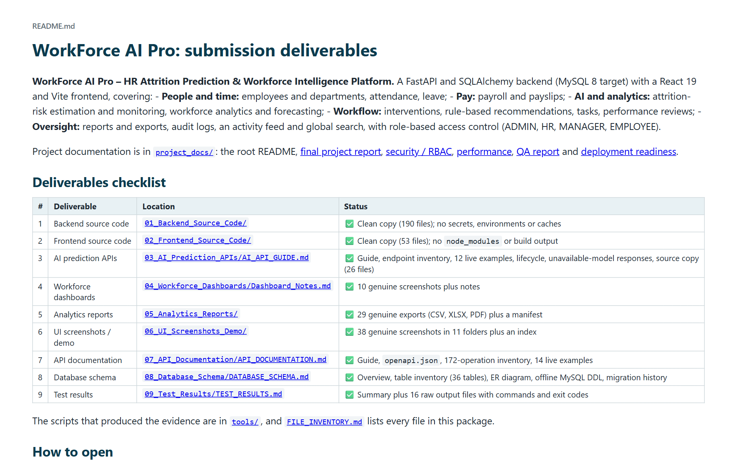
Deliverables README

Slide 56
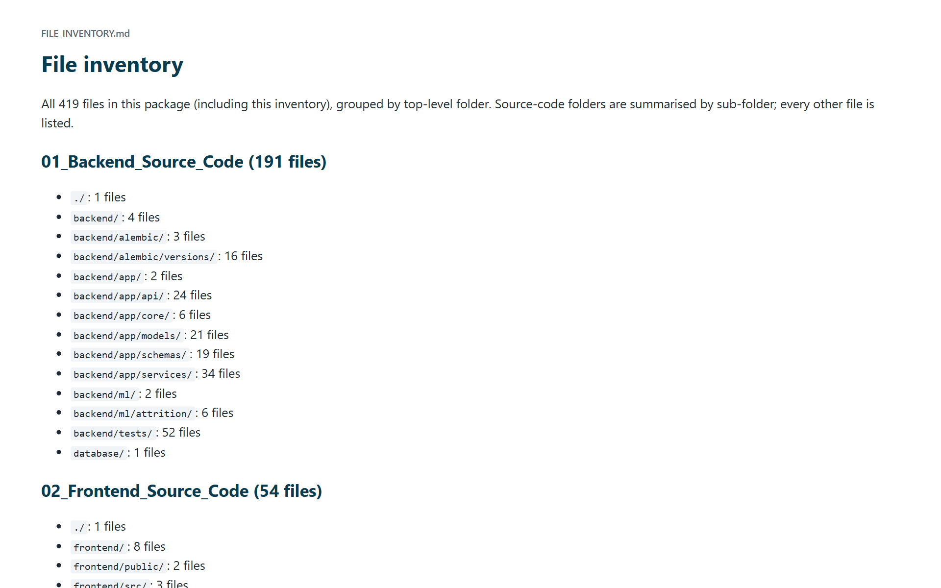
File inventory

Slide 57
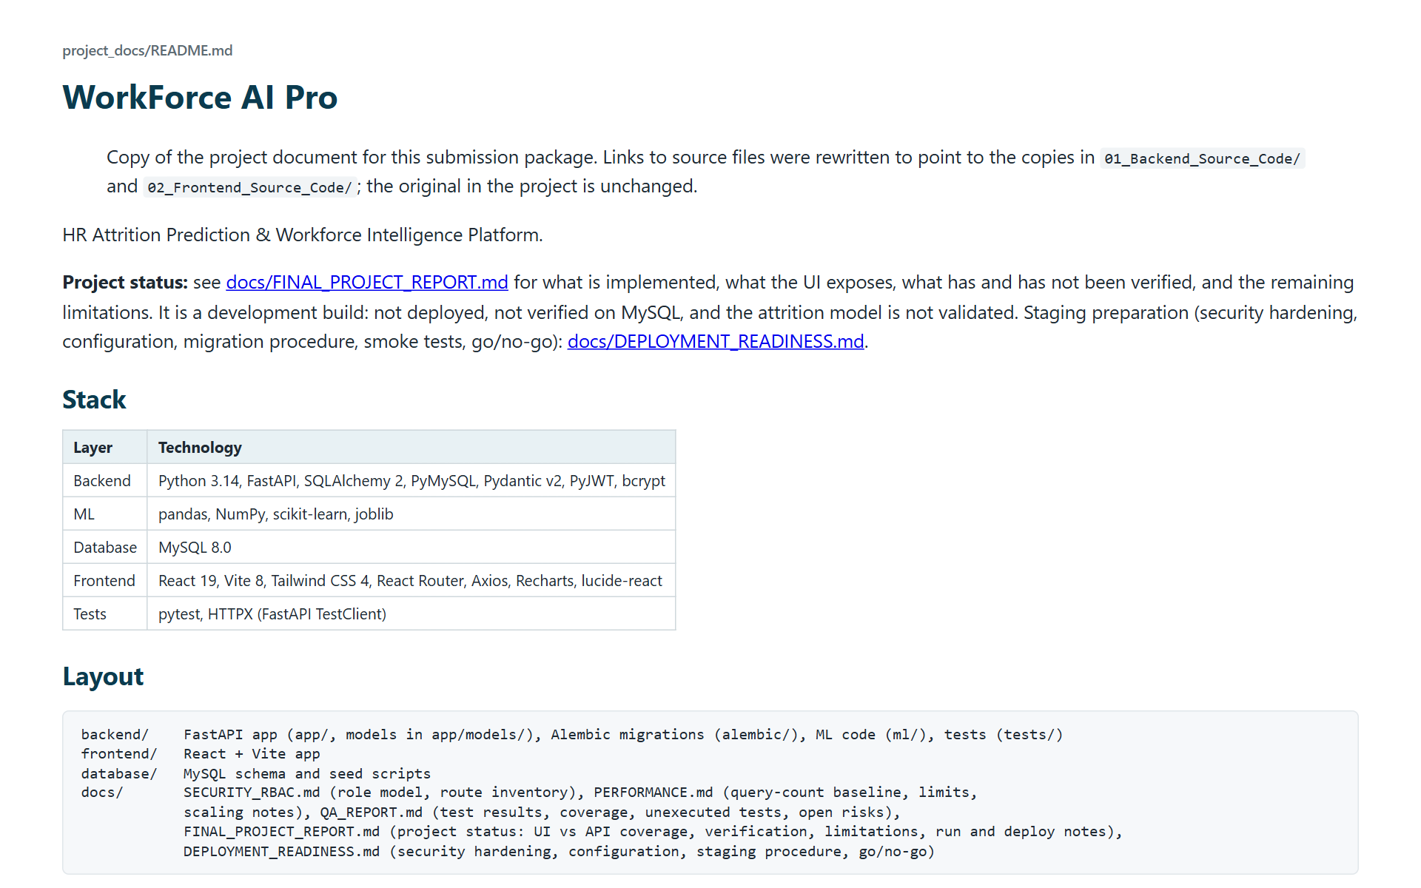
Project docs README

Slide 58
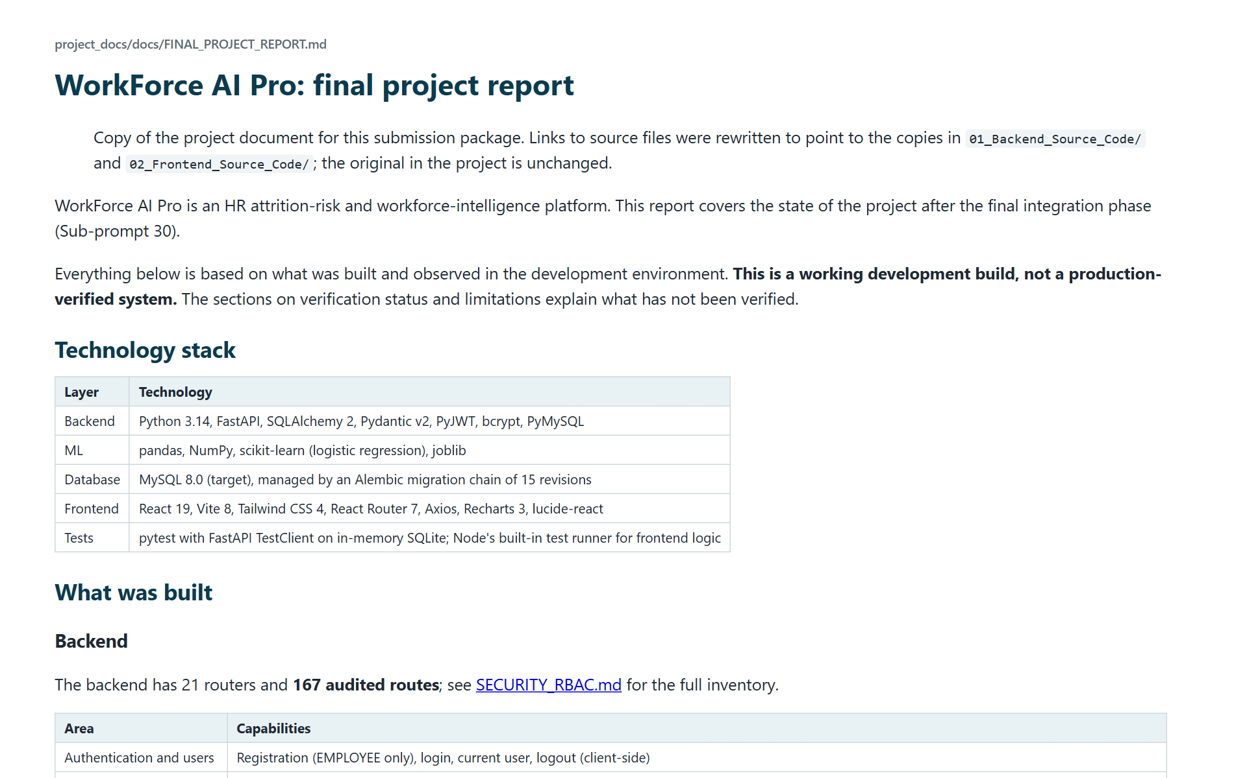
Final project report

Slide 59
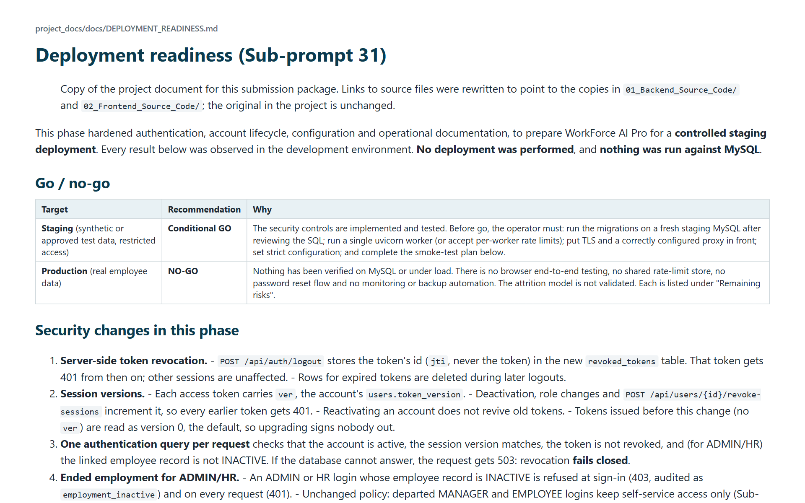
Deployment readiness

Slide 60
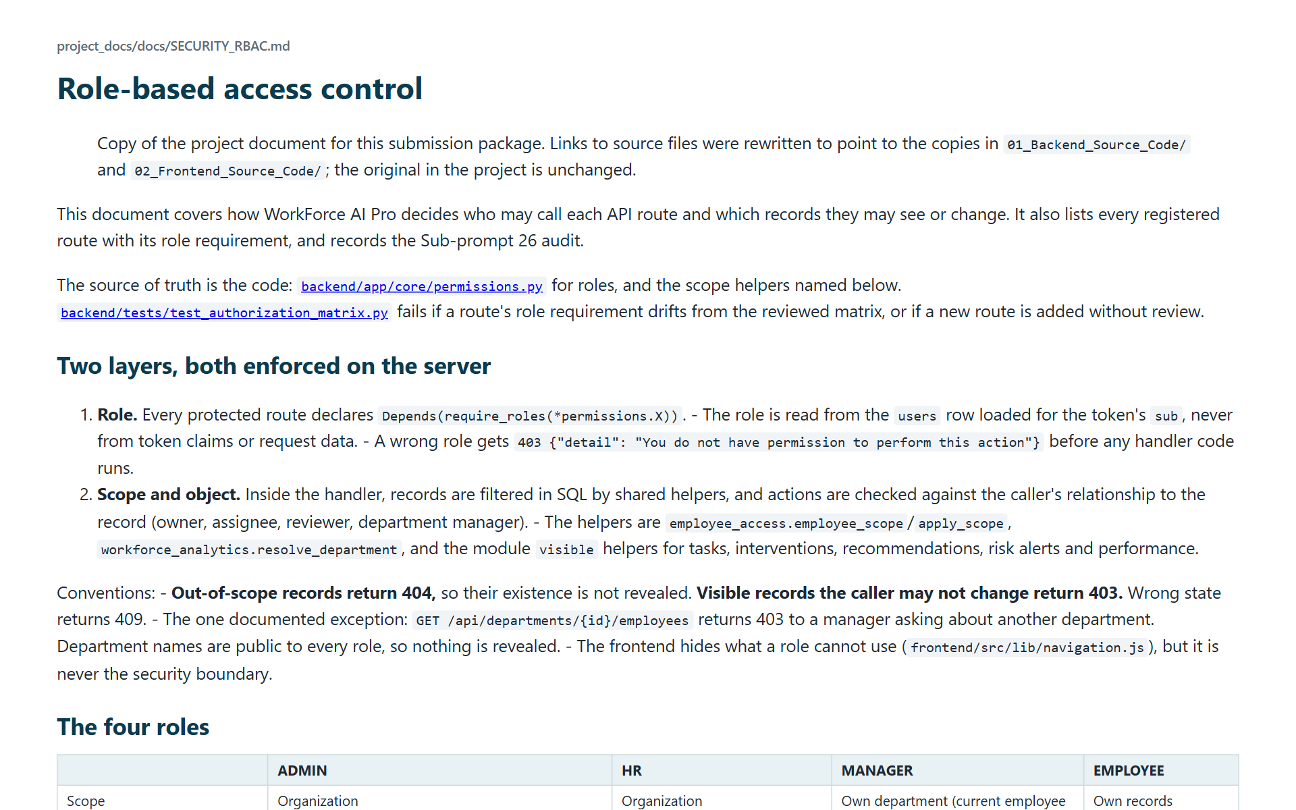
Security and RBAC

Slide 61
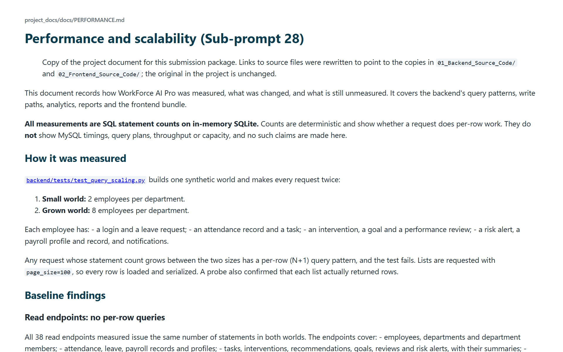
Performance

Slide 62
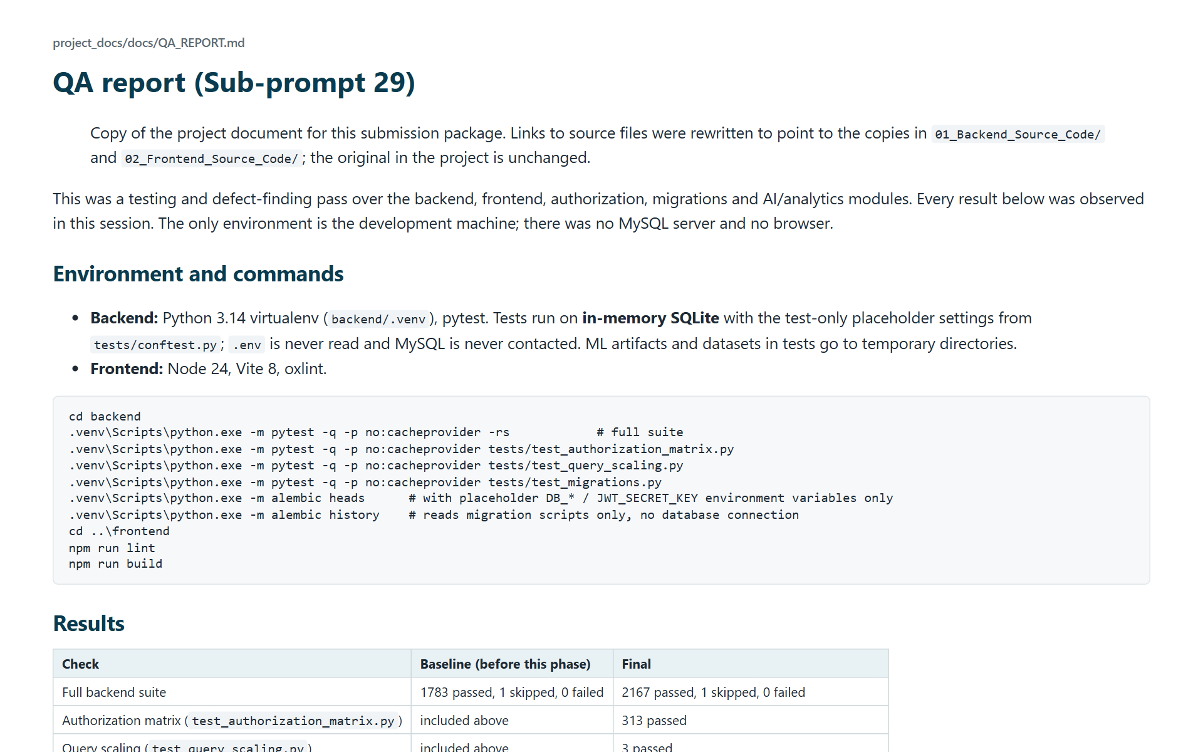
QA report

Slide 63
Backend Source Code
Backend README files and folder structure

Slide 64
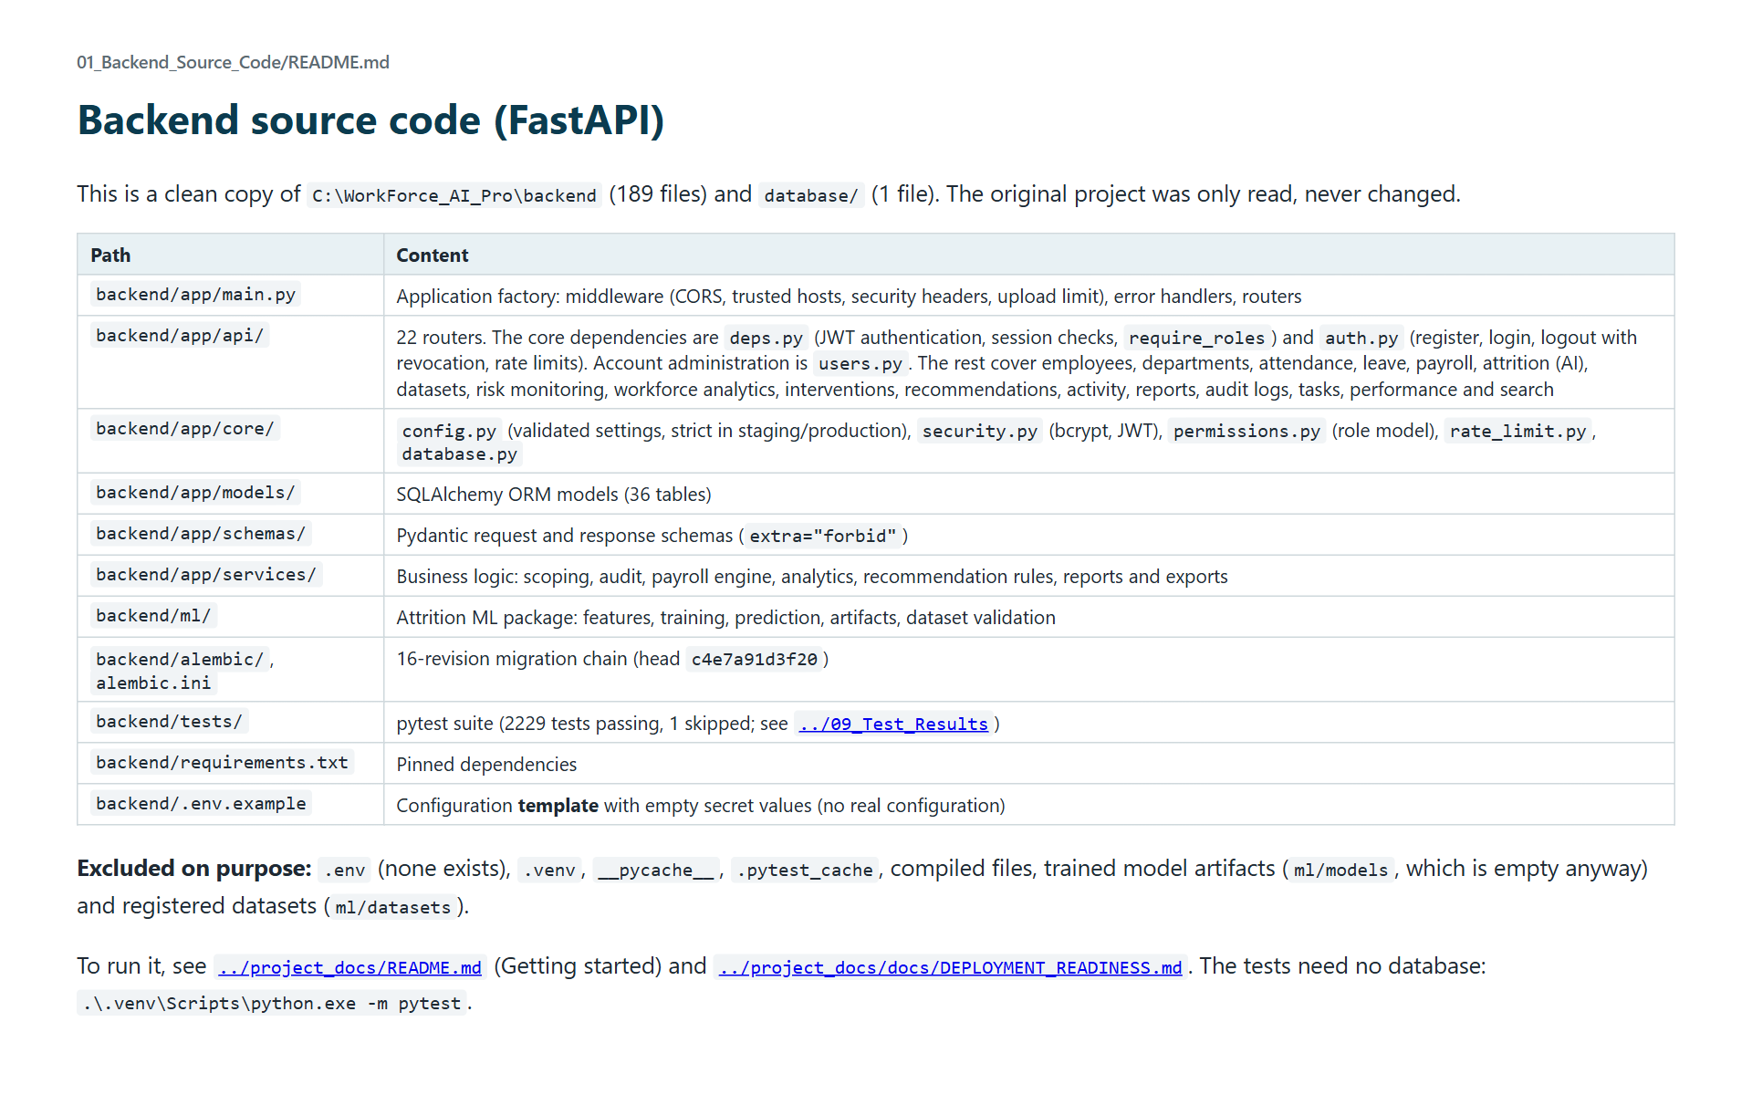
Backend source code README

Slide 65
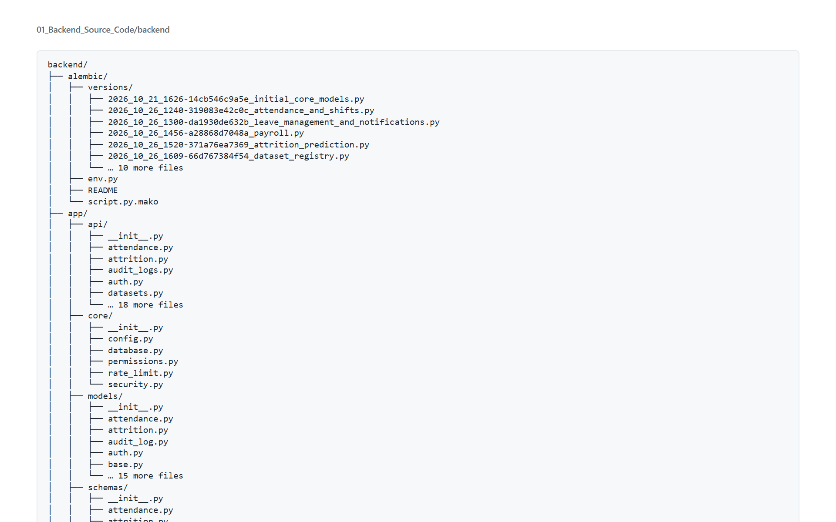
Backend source code folder structure

Slide 66
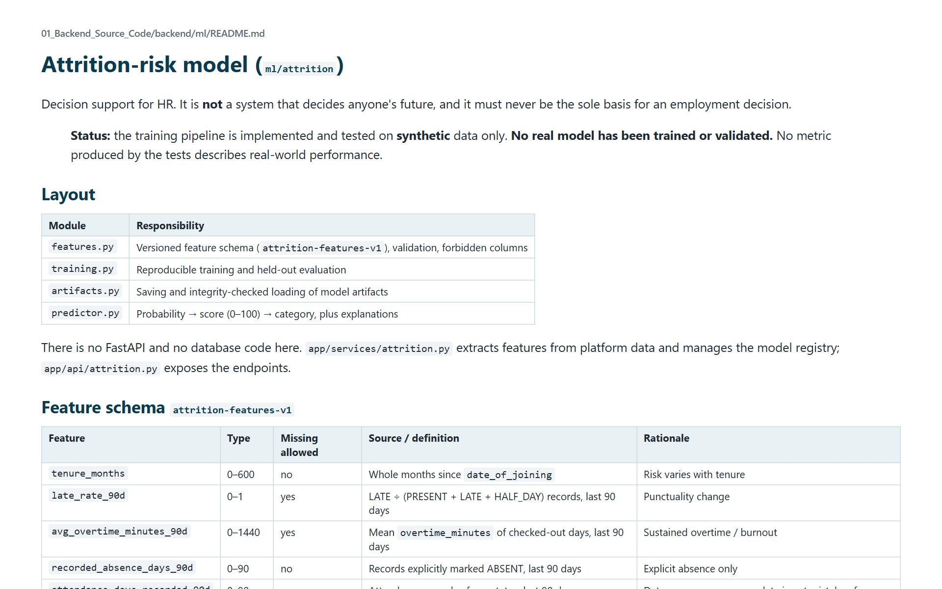
ML module README

Slide 67

Database setup README

Slide 68
Frontend Source Code
Frontend README and folder structure

Slide 69

Frontend source code README

Slide 70

Frontend source code folder structure

Slide 71
AI Prediction APIs
API guide, folder structure and example responses

Slide 72

AI prediction API guide

Slide 73

AI prediction APIs folder structure

Slide 74

AI API example: Dataset Validation Report

Slide 75

AI API example: Datasets

Slide 76

AI API example: Model Status

Slide 77

AI API example: Monitoring Run

Slide 78

AI API example: Predict Batch with Unknown ID

Slide 79

AI API example: Predict Forbidden for Employee

Slide 80

AI API example: Predict One

Slide 81

AI API example: Prediction History

Slide 82

AI API example: Revalidate Validated (409)

Slide 83

AI API example: Risk Alerts

Slide 84

AI API example: Risk Summary

Slide 85

AI API example: Train Forbidden for HR

Slide 86
Analytics Reports
Generated PDF, Excel and CSV reports

Slide 87

Analytics reports README

Slide 88

Report manifest

Slide 89

Activity report (PDF)

Slide 90

Attendance report (PDF)

Slide 91

Attrition report (PDF)

Slide 92

Audit log report (PDF)

Slide 93

Employees report (PDF)

Slide 94

Leave report (PDF)

Slide 95

Payroll report (PDF)

Slide 96

Workforce report (PDF)

Slide 97

Activity report, organization (Excel)

Slide 98

Attendance report, organization (Excel)

Slide 99

Attrition report, organization (Excel)

Slide 100

Employees report, organization (Excel)

Slide 101

Leave report, organization (Excel)

Slide 102

Payroll report, organization (Excel)

Slide 103

Workforce report, organization (Excel)

Slide 104

Activity report, organization (CSV)

Slide 105

Attendance report, organization (CSV)

Slide 106

Attrition report, organization (CSV)

Slide 107

Audit log report, organization (CSV)

Slide 108

Employees report, organization (CSV)

Slide 109

Leave report, organization (CSV)

Slide 110

Payroll report, organization (CSV)

Slide 111

Workforce report, organization (CSV)

Slide 112

Activity report, department (CSV)

Slide 113

Attendance report, department (CSV)

Slide 114

Attrition report, department (CSV)

Slide 115

Employees report, department (CSV)

Slide 116

Leave report, department (CSV)

Slide 117

Workforce report, department (CSV)

Slide 118
API Documentation
API reference, endpoint inventory and OpenAPI spec

Slide 119

API documentation

Slide 120

Endpoint inventory

Slide 121

OpenAPI specification

Slide 122

API example: Employee List Paginated

Slide 123

API example: Health

Slide 124

API example: Login Success

Slide 125

API example: Login Wrong Password

Slide 126

API example: Me

Slide 127

API example: Missing Token (401)

Slide 128

API example: Out of Scope (404)

Slide 129

API example: Report Catalog Manager

Slide 130

API example: Role Forbidden (403)

Slide 131

API example: Search

Slide 132
API example: Unknown Filter (422)

Slide 133
API example: Users Admin List

Slide 134
API example: Users Forbidden for HR

Slide 135
API example: Validation Error (422)

Slide 136
Database Schema
Schema, table inventory, ER diagram and migrations

Slide 137
Database schema

Slide 138
Table inventory

Slide 139
Entity relationship diagram

Slide 140
MySQL schema script

Slide 141
Migration history

Slide 142
Test Results
Test summary and raw test, build and lint output

Slide 143
Test results summary

Slide 144
Backend full test suite output

Slide 145
Frontend test output

Slide 146
Frontend build output

Slide 147
Frontend lint output

Slide 148
Tools
Scripts used to produce these deliverables

Slide 149
Tools README

Slide 150
Tools folder contents

